Slide 1

Habit 6: Synergize
The Habit of Creative Cooperation
The 7 Habits of Highly
Effective College Students
Learning Frameworks

Slide 2
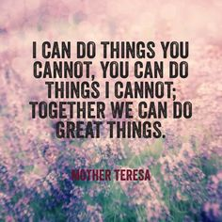
https://www.youtube.com/watch?v=qRPhtEUYVKQ

Slide 3

THE 7 HABITS OF HIGHLY EFFECTIVE COLLEGE STUDENTS:
Succeeding in College…and in Life
BE PROACTIVE
BEGIN WITH THE END IN MIND
PUT FIRST THINGS FIRST
THINK WIN –WIN
SEEK FIRST TO UNDERSTAND, THEN TO BE UNDERSTOOD
SYNERGIZE
SHARPEN THE SAW

Slide 4

THE 7 HABITS OF HIGHLY EFFECTIVE COLLEGE STUDENTS:
Succeeding in College…and in Life
“Alone we can do so little; together we can do so much.”
~Helen Keller
In this chapter, you will discover ways to:
Value differences.
Build complementary teams.
Go for the 3rd Alternative.
Remove barriers to synergy.

Slide 5
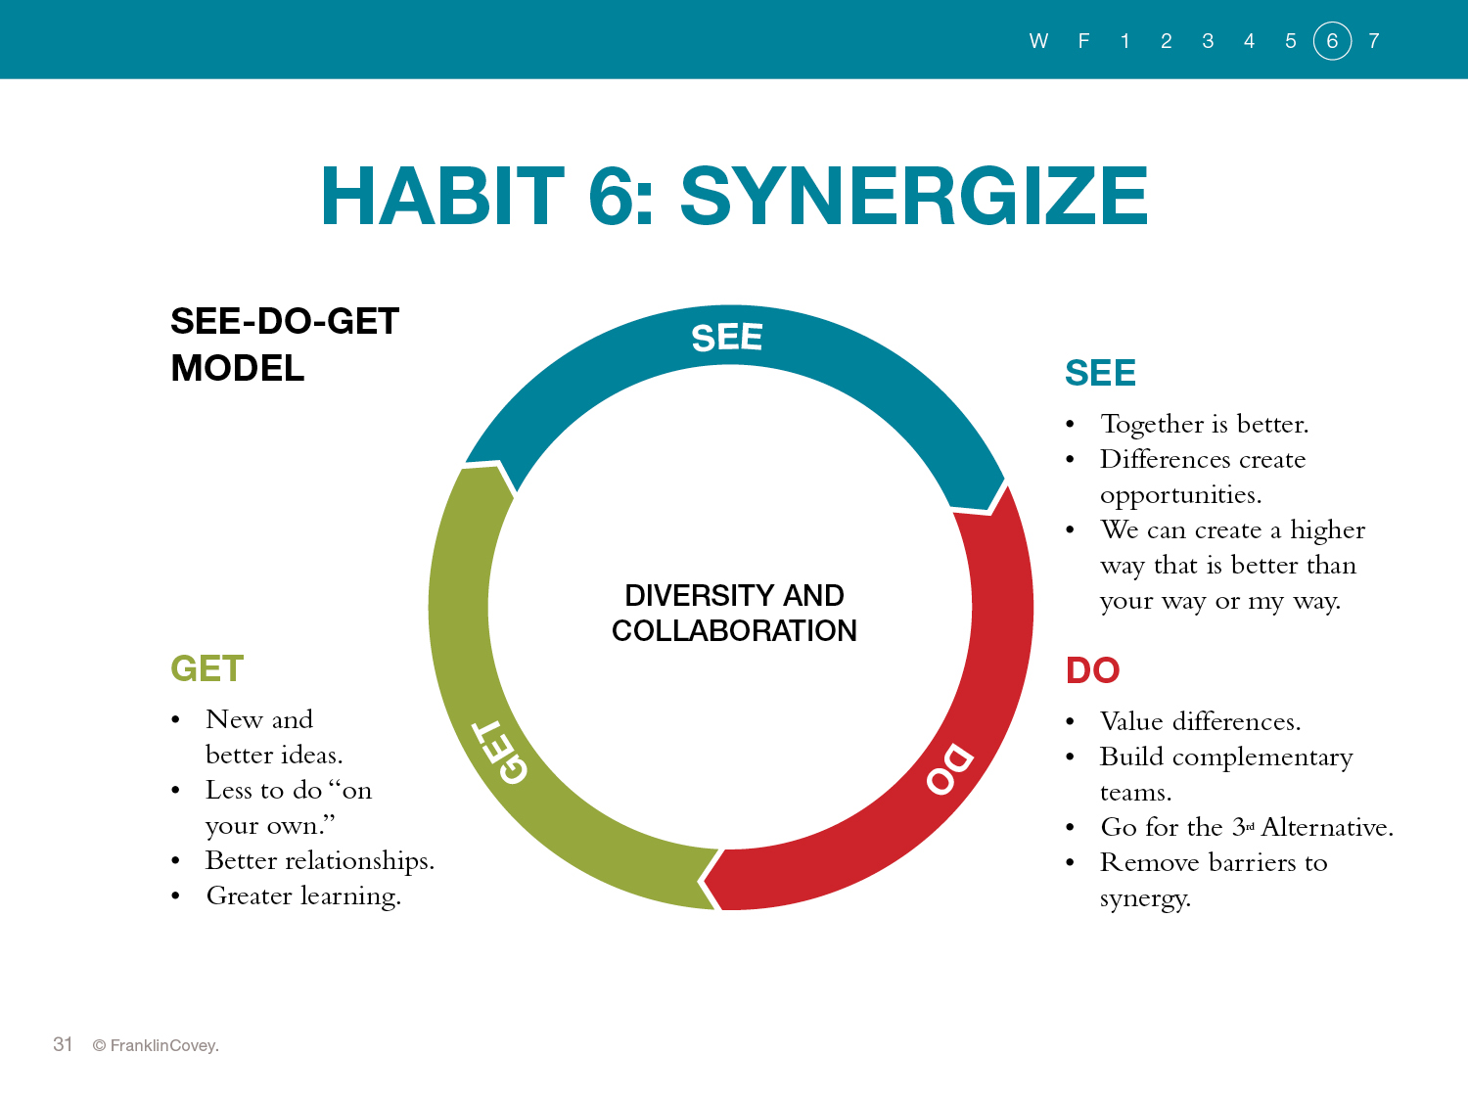

Slide 6

Notes:
Sergey and Larry—textbook p. 225
Both computer science majors at Stanford
Sergey—party guy, gave campus tours, ambitious, curious
Larry—shy and reserved, patient
They were assigned to work together for a class project
Disagreed on almost everything, opposite personalities
They were looking for new ways to search the internet—at that time a search yielded word frequencies. Larry’s idea was to search for links, not words.
They called it “Backrub” because it counted the number of links back to an original website.
Today over 1 billion people/day use it---now called Google
They needed each other’s strengths

Slide 7
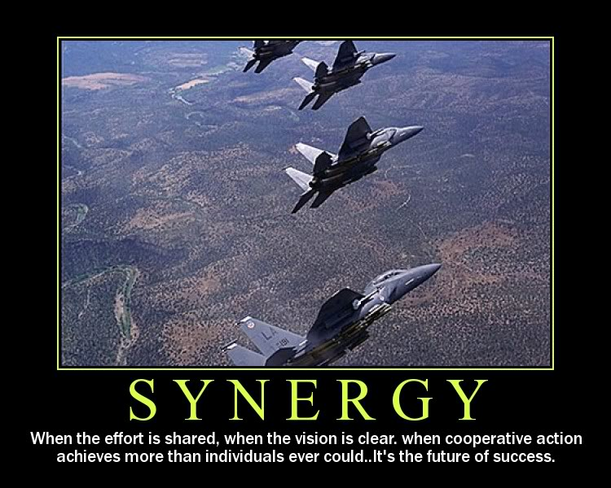
Notes:
Write these on the board:
Life is a team sport
Interdependence is better than independence
You can always do better working with others than alone
You don’t always need to have the best ideas
Other people’s strengths can make up for your weaknesses
Best way is not “my way” or “your way,” but a higher way we create together.

Slide 8
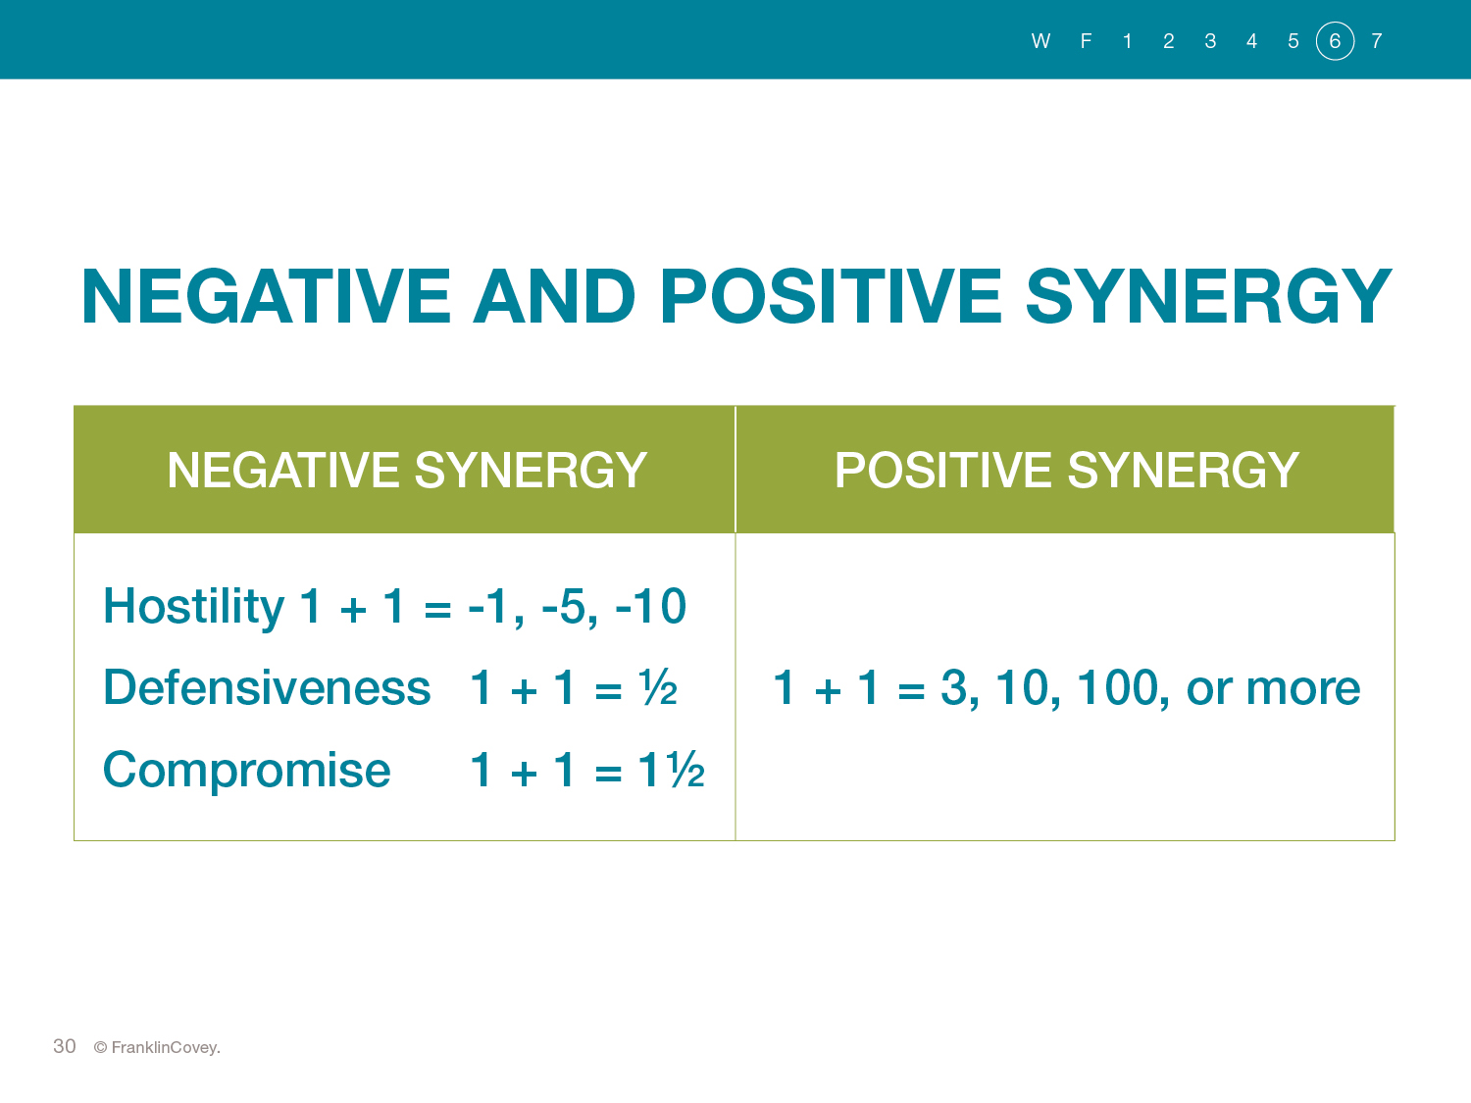
Notes:
Synergy is a principle—a natural law
We see it all the time—especially in nature. Two trees resist wind better if their roots are mingled
Discuss what the terms mean on the slide
Hostile
Defensive
Compromise—really lose/lose
Ask them what the numbers mean. Remember synergy implies that the whole is bigger than the parts—not smaller (negative numbers)

Slide 9
Habit 4 is the root, Habit 5 is the route, Habit 6 is the fruit.
Notes:
Discuss what this means.
Habit 6 is the destination—only people rooted in win-win and following seek first to understand can harvest the fruits of synergy.

Slide 10
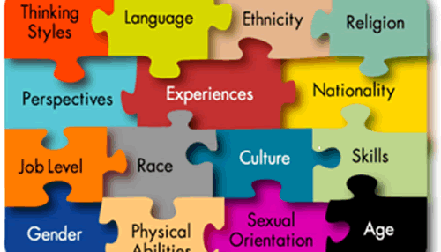
Value Differences
Ways of dealing with diversity
The shunner
The tolerator
The celebrator
Activity #41—Just How Intelligent Are You? P. 231
Which one are you? How did you deal with diversity in the breakout challenge?
Notes:
These ways of dealing with diversity are really a continuum—one morphs into the next.

Slide 11
The main ingredient of stardom is the rest of the team.
~John Wooden
Notes:
I’m not sure what this is!!

Slide 12

Building Complementary Teams
5 types of people
Plodders
Followers
Innovators
Harmonizers
Show-offs
Notes:
Types discussed p. 234
Team needs to have all different kinds of people with different strengths
To recruit these others, you first have to know what your own strengths are.

Slide 13
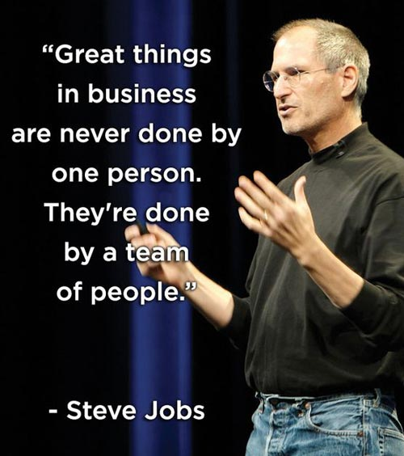

Slide 14
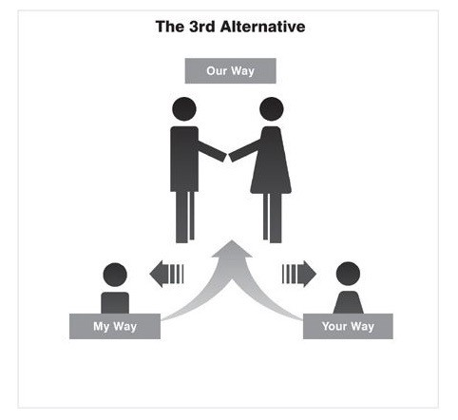
Go for the 3rd Alternative
Steps:
Define the problem
Listen to their views
Share your views
Brainstorm
Choose the best idea
p. 238
Notes:
Go through each step—p. 238
Ask for student volunteers to read aloud scenario pp. 239-240
How do you know you have arrived at 3rd alternative?
Everybody has a firm change of heart
Feels new energy and excitement
Sees things a new way
Feels the relationship has been transformed
Loves the solution—a better solution than anyone could come up with alone.

Slide 15

Remove Barriers to Synergy
Roadblocks
Ego
No private victory
Win-lose thinking
Cliques
pp. 242-243
Notes:
Go through each one (pp. 242-243) asking class what each means.

