Slide 1

Introduction to
the Resource Book…
The 7 Habits of Highly
Effective College Students
Succeeding in College…and in Life
Learning Frameworks Course

Slide 2
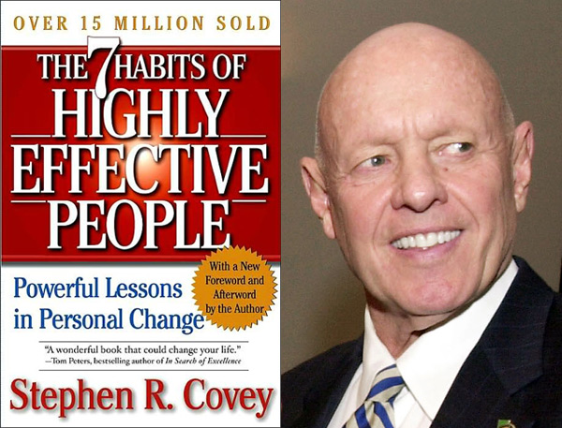
Foundation
based upon global bestselling book:
7 Habits of Highly Effective People
STEPHEN R. COVEY
Notes:
Franklin Planners Company merged with Covey Organization to form FranklinCovey. FranklinCovey is a global company specializing in performance improvement. They help organizations achieve results that require a change in human behavior. They provide international training in Leadership, Execution, Productivity, Trust, Sales Performance, Customer Loyalty and Education

Slide 3

MILESTONES
In 2002, Forbes named The 7 Habits of Highly Effective People one of the top 10 most influential management books ever.
A survey by Chief Executive magazine recognized The 7 Habits of Highly Effective People as one of the two most influential books of the 20th century.
The 7 Habits of Highly Effective People audiobook on tape is the best-selling nonfiction audio in history, selling more than a million and a half copies.
Notes:
First Published in 1989

Slide 4

Additional book:
The 8th Habit: From Effectiveness to Greatness
STEPHEN R. COVEY

Slide 5
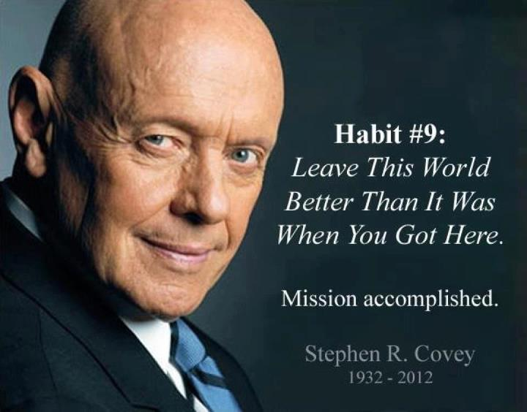

Slide 6

FranklinCovey’s additional book:
The 7 Habits of
Highly Effective Teens
SEAN COVEY

Slide 7

The 7 Habits of
Highly Effective College Students
Succeeding in College…and in Life
SEAN COVEY

Slide 8

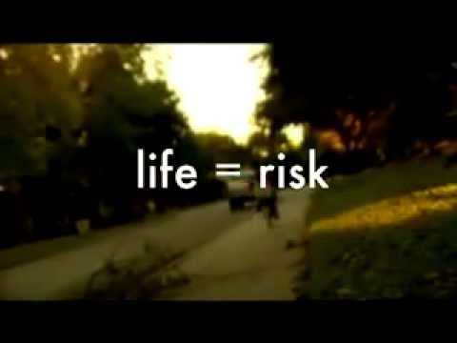
THE 7 HABITS OF HIGHLY EFFECTIVE COLLEGE STUDENTS:
Succeeding in College…and in Life
Introduction

Slide 9
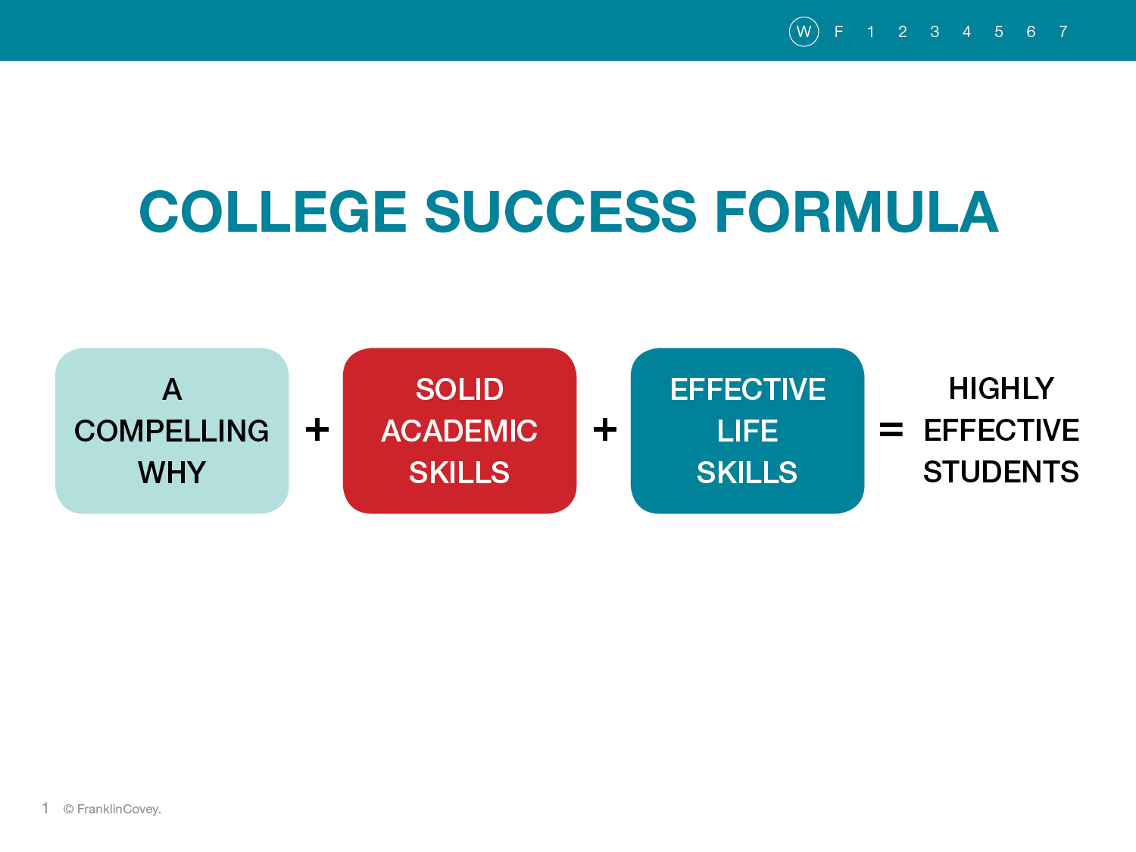
Notes:
Compelling why—Top three reasons you want to go to college?
Are your reasons strong enough to overcome obstacles that might get in your way?
Solid Academic Skills—We have discussed strategies to help you be successful academically: writing, reading, test taking strategies, studying, note taking, critical thinking, researching and presenting
Effective Life Skills: managing time, setting goals, communicating well, managing finances, resolving conflicts, building friendships, caring for your health, dealing with difficult people, and working in teams.

Slide 10
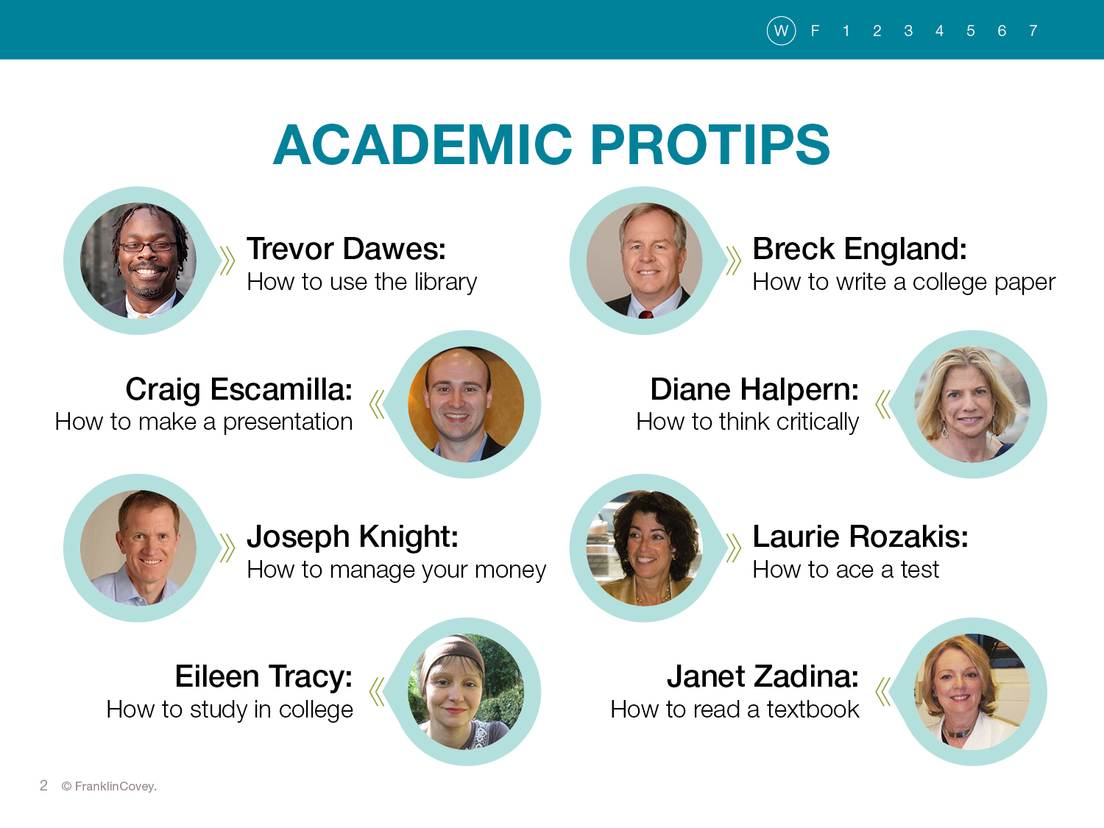
Notes:
These will not be covered in class although some of the topics have been at previous times. I encourage you to review all of them. However, I strongly encourage you to read the one on How to make a presentation. It is on page 220.

Slide 11
THE 7 HABITS OF HIGHLY EFFECTIVE COLLEGE STUDENTS:
Succeeding in College…and in Life
What are the 7 Habits?

Slide 12

THE 7 HABITS OF HIGHLY EFFECTIVE COLLEGE STUDENTS:
Succeeding in College…and in Life
BE PROACTIVE
I am responsible for my education and life.
HABIT 1

Slide 13

THE 7 HABITS OF HIGHLY EFFECTIVE COLLEGE STUDENTS:
Succeeding in College…and in Life
BEGIN WITH THE END IN MIND
I have a plan for what I want to accomplish.
HABIT 2

Slide 14

THE 7 HABITS OF HIGHLY EFFECTIVE COLLEGE STUDENTS:
Succeeding in College…and in Life
PUT FIRST THINGS FIRST
I do the most important things first.
HABIT 3

Slide 15

THE 7 HABITS OF HIGHLY EFFECTIVE COLLEGE STUDENTS:
Succeeding in College…and in Life
THINK WIN-WIN
I am considerate of others, but I also have the courage to stand up for myself.
HABIT 4

Slide 16

THE 7 HABITS OF HIGHLY EFFECTIVE COLLEGE STUDENTS:
Succeeding in College…and in Life
SEEK FIRST TO UNDERSTAND, THEN TO BE UNDERSTOOD
I hear people out before expressing my own opinion.
HABIT 5

Slide 17

THE 7 HABITS OF HIGHLY EFFECTIVE COLLEGE STUDENTS:
Succeeding in College…and in Life
SYNERGIZE
I value the strengths of other people and combine them with my own to solve problems.
HABIT 6

Slide 18

THE 7 HABITS OF HIGHLY EFFECTIVE COLLEGE STUDENTS:
Succeeding in College…and in Life
SHARPEN THE SAW
I regularly recharge my body, heart, mind, and spirit so I can stay sharp and improve myself.
HABIT 7

Slide 19
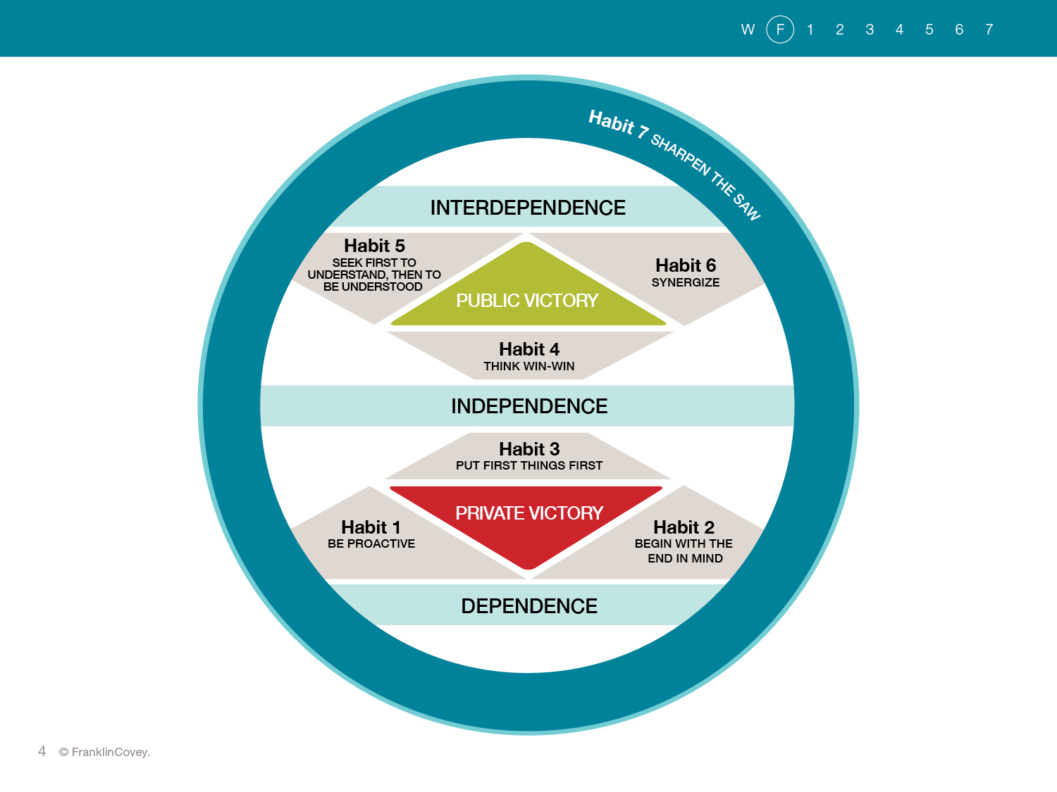
Notes:
The 7 Habits Leadership Continuum:
The 7 Habits build on one another.
You move from dependence (childhood) to independence as you take on more responsibility for your life (Habit 1), work toward meaningful goals (Habit 2) and use your time well (Habit 3). As you become more independent, we call it winning the private victory.
While being independent is good, there is a higher sate to strive for: interdependence. At home, at work and at school, we must work well with others to be successful. Going for the win-win (Habit 4), understanding others (Habit 5), and valuing peoples differences (Habit 6) make you more interdependent. We call that winning the public victory.
As you move up the Leadership continuum, becoming more and more interdependent, you truly become a leader---a leader of your life and a leader among your peers.
Notice that the private victory comes before the public victory. You have got to get your own act together , at least to some degree, before you can succeed with other people.
Habit 7: Sharpen the Saw surrounds all the other habits. It is a habit of renewal. You must do something everyday to recharge your body, mind, spirit, and emotional life.

Slide 20

The Power of a PARADIGM:
The way you see things is called your PARADIGM.

Slide 21

What Do You Really See?
Foundation
7
Notes:
What do you see? Quietly analyze the figure and jot down what you see?
Who sees a big nosed man playing a saxophone?
Who sees a beautiful woman?
Who sees both?
We all see the same figure but it has different meanings to each of us.

Slide 22
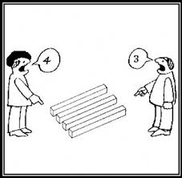

Slide 23


Slide 24

In other words:
Mindset
Perception
Belief System
Frame of Reference
Point of View

Slide 25
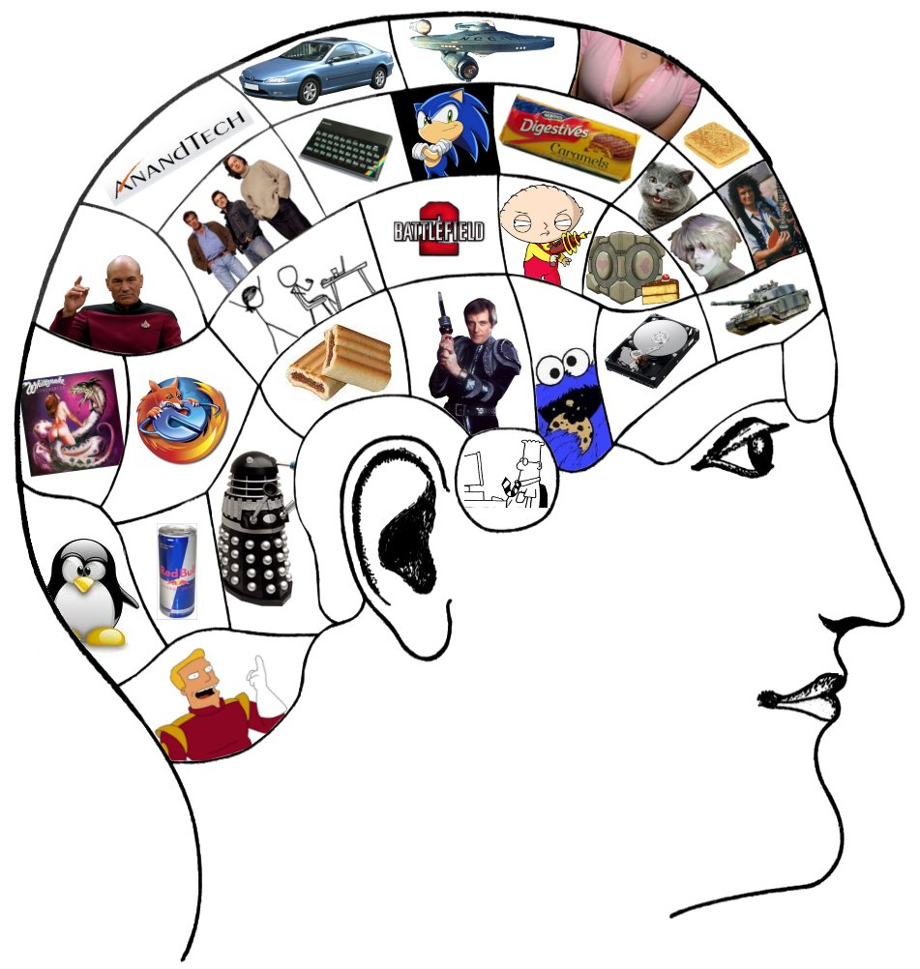
Your brain is packed with paradigms!

Slide 26

You have paradigms about:
Politics
Religion
Society
Sports
Music
Movies
Studying
College

Slide 27
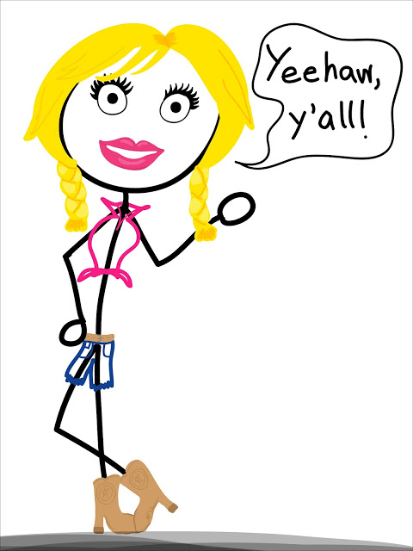
Country music is awful!

Slide 28

I’m NOT a morning person!

Slide 29
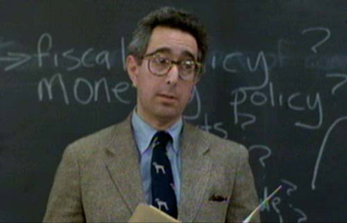
My professors don’t care about anyone else but themselves.

Slide 30

Did You Know?
The word “Paradigm” comes from the Greek (paradeigma), meaning PATTERN or EXAMPLE?

Slide 31

Your paradigms are like lenses through which you view the world.

Slide 32
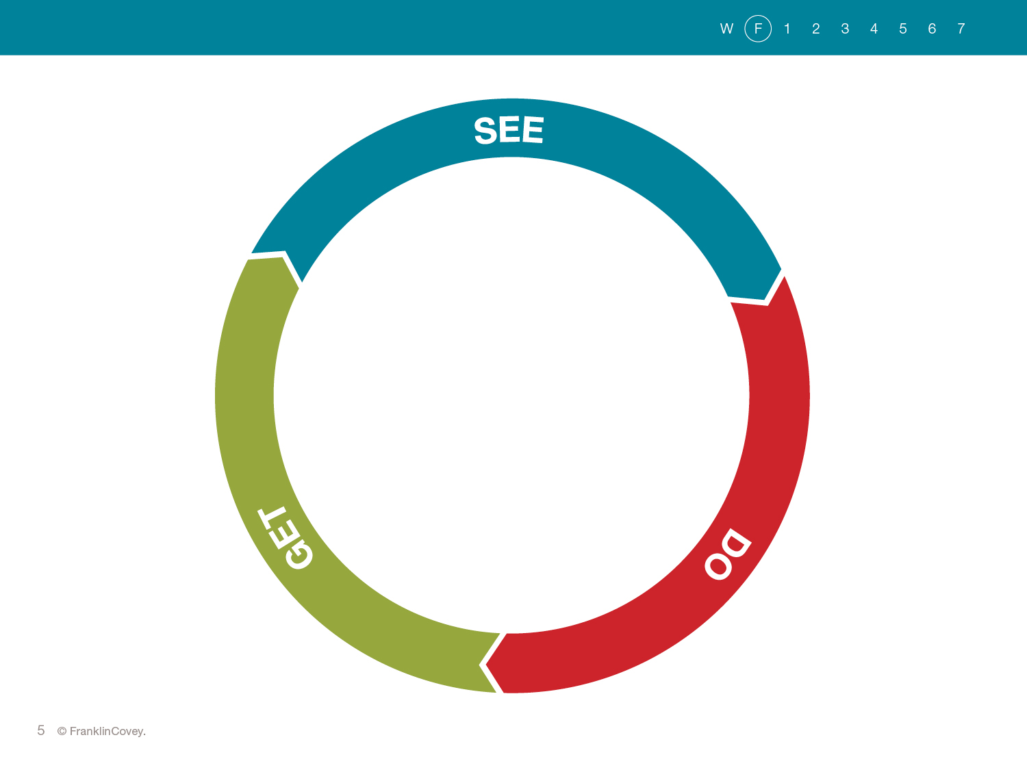
Notes:
The results you GET in life flow from the things you DO, which in turn flow from the way you SEE things.
We call this the See-Do-Get Cycle.
This See-Do-Get Cycle is at work in your life. How you see things will impact what you DO, and what your DO will impact the results you GET. Then the results you GET will impact how you SEE things and so on.
Page 24—Read
What you see is what you get. If you see yourself as a confident person who can succeed with the right kind of help, you probably will succeed.
This ties back to the self-efficacy lesson we talked about in a lesson earlier this semester.

Slide 33

Dr. Stephen Covey
Had a PARADIGM SHIFT on a subway……

Slide 34

Another Example:
“I didn’t realize that others were listening to me and valued my opinion.”

Slide 35

My personal experiences:
What has shaped your paradigms?

Slide 36

College through a POSITIVE lense:
Great opportunity
Life-long friendships
Useful information
Interesting
Preparation for a meaningful career

Slide 37

College through a NEGATIVE lense:
An obnoxious rite of passage to a good job
Exams and assignments as meaningless tasks
Research papers as “killing trees”

Slide 38
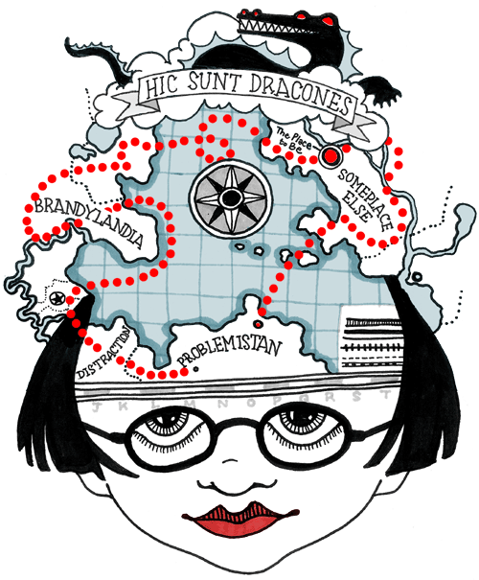
If you have the wrong mental maps, you are not going to make it to your destination!

Slide 39
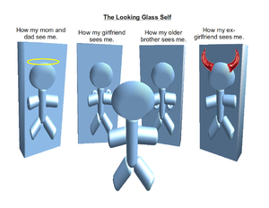
The MOST important paradigm is the paradigm of YOURSELF!

Slide 40
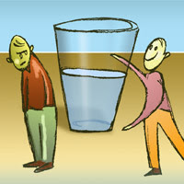
Negative Self-Paradigms:
I’m terrible at making new friends.
I’m awful at taking tests.
Appearance is everything in a relationship, and I’m not beautiful so……
I don’t know if I’m the college type.
College is way too expensive. I’ll never be able to pay for it.

Slide 41

Positive Self-Paradigms:
I like meeting new people.
If I study intelligently, I can do well.
I’m comfortable in my own skin.
I’m going to be the first in my family to graduate from college.
With a little help, I can work my way through college.

Slide 42

Your self-paradigms directly impact your self-esteem!

Slide 43

No one’s paradigms are totally accurate!
College is for obtaining an education as well as expanding your paradigms.

Slide 44

A more current example:
Is the Internet melting our brains and making us unable to concentrate?
Yes? No?
People on both sides are certain they are right!

Slide 45

“I’m not the college type – that’s just not me.”
Fact?
False belief that you have talked yourself into?

Slide 46

When a person’s paradigm changes it’s called a PARADIGM SHIFT.

Slide 47

Straight out of High School:
People talk differently.
People act differently.
Demands are higher.
There is more responsibility.
Rules are different.

Slide 48
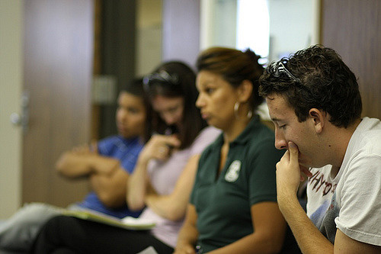
Returning to School:
School is not how you remember it.
You might be older than your teacher!
You might be overwhelmed by technology.

Slide 50
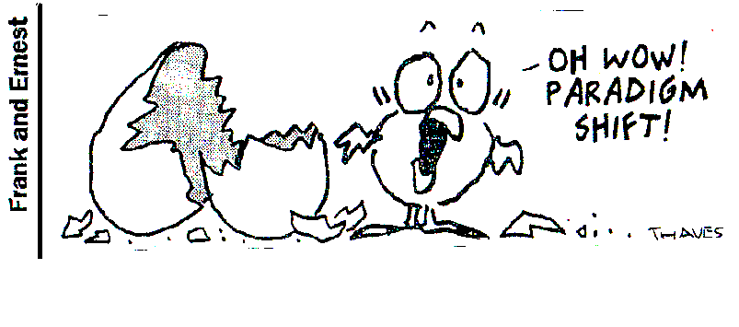
While Paradigm Shifts can make you nervous, they are almost always a change for the better!

