Slide 1
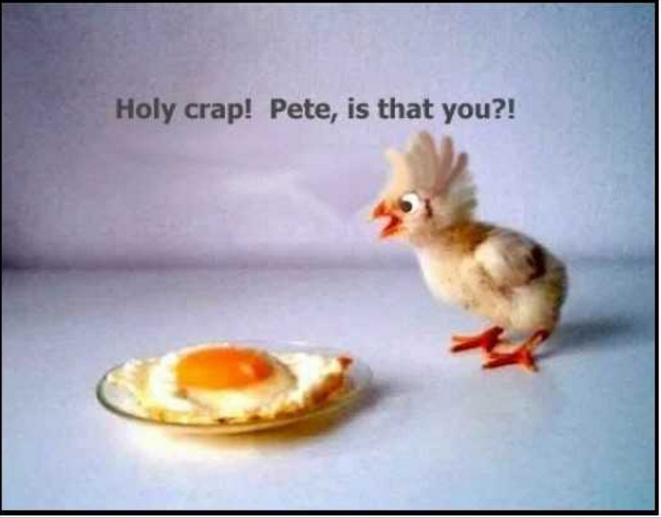
PLEASE BEGIN WORKING ON THE “THREE KEY IDEAS” ASSIGNMENT ON PAGE 17 IN YOUR PACKET.
*DO NOT JUST FOCUS ON THE ARTICLE WE READ.
YOU SHOULD INCLUDE YOUR THOUGHTS ABOUT ANYTHING WE TALKED ABOUT IN CLASS REGARDING “GROWING YOUR BRAIN.” (NEUROPLASTICITY)
*BE THOROUGH IN YOUR ANSWERS! ONE SHORT SENTENCE WILL NOT EARN YOU FULL CREDIT! ☺
-Please begin working on the “Three Key Ideas” assignment in your packet (page 17.)
-Do not just include ideas from the article. You should reflect on anything we discussed in class regarding how to “grow your brain” and the concept of neuroplasticity.
-Be thorough in your answers! One short sentence will not earn you full credit. ☺

Slide 2
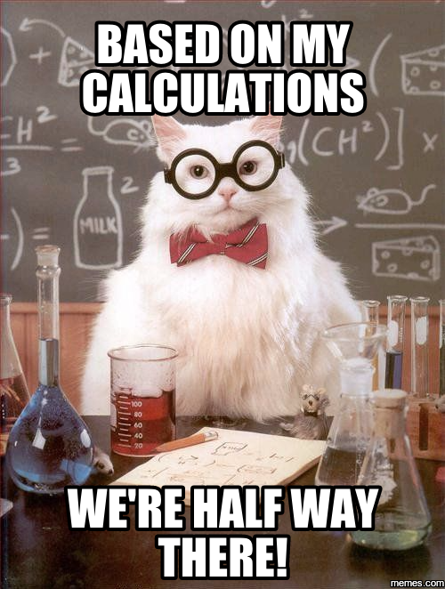

Slide 3
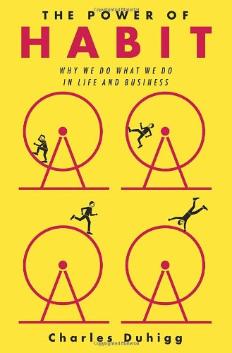
HABITS: HOW TO MAKE THEM OR BREAK THEM

Slide 4
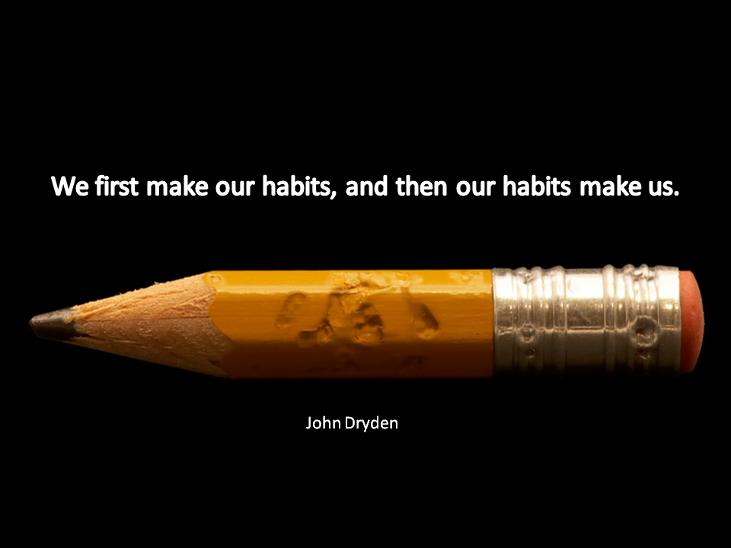
Notes:
The question therefore is – if we are spending almost half of our time in habit mode - what are our habits doing for us? What results are our habits delivering, the results we are seeking? Are they taking us towards where we want to go or are they like stealth experts that sneak up upon us unknowingly and spookily hijack our day?
Are our current habits acting more like kryptonite than superpowers? Therein lies the answer to much of our success as emerging and future leaders.

Slide 5
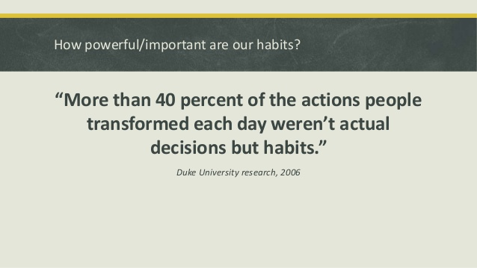

Slide 6
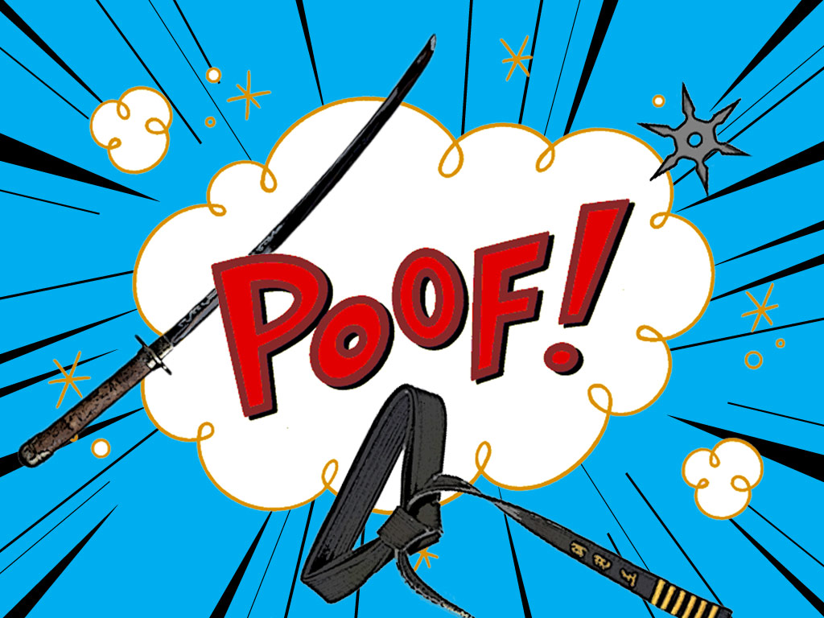
Notes:
So let’s start off with a little fun exploring personal habits – one’s that really push your buttons! Write down the top five most annoying habits of the people you love that you wish you could wave a magic wand and just make them disappear! (The habit…not the person)

Slide 7
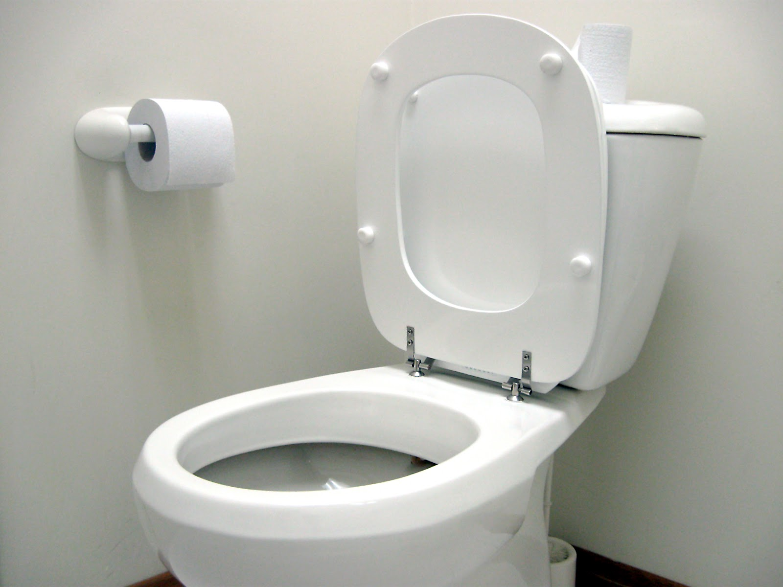
Notes:
How many tables DIDN’T have this?? ☺
How many of you shared habits of other people?
How many of you shared habits of your partners?
How many of you fessed up to your own habits?

Slide 8
“Habits are the choices that all of us deliberately make at some point and then stop thinking about but continue doing, often every day”
Charles Duhigg, author of ‘The Power of Habit’
Notes:
According to investigative journalist Charles Duhigg and author of ‘The Power of Habit’, “habits are the choices that all of us deliberately make at some point, and then stop thinking about but continue doing, often every day”.
We're often unaware of the point in time that we stop thinking about them and that they have become exactly that – a habit
The value of a habit is you don’t have to think about it. It frees up your brain to do other things. We need habits. Can you imagine having to re-teach yourself each morning how to brush your teeth (many of you are still doing that with your children!) or how to make a packed lunch? You wouldn’t get anywhere and would be overwhelmed.
Our brains are efficiency machines and they create habit to save energy.
So when it comes to our brains and habits, are they our friend or foe? Are they our kryptonite or our superpower?

Slide 9
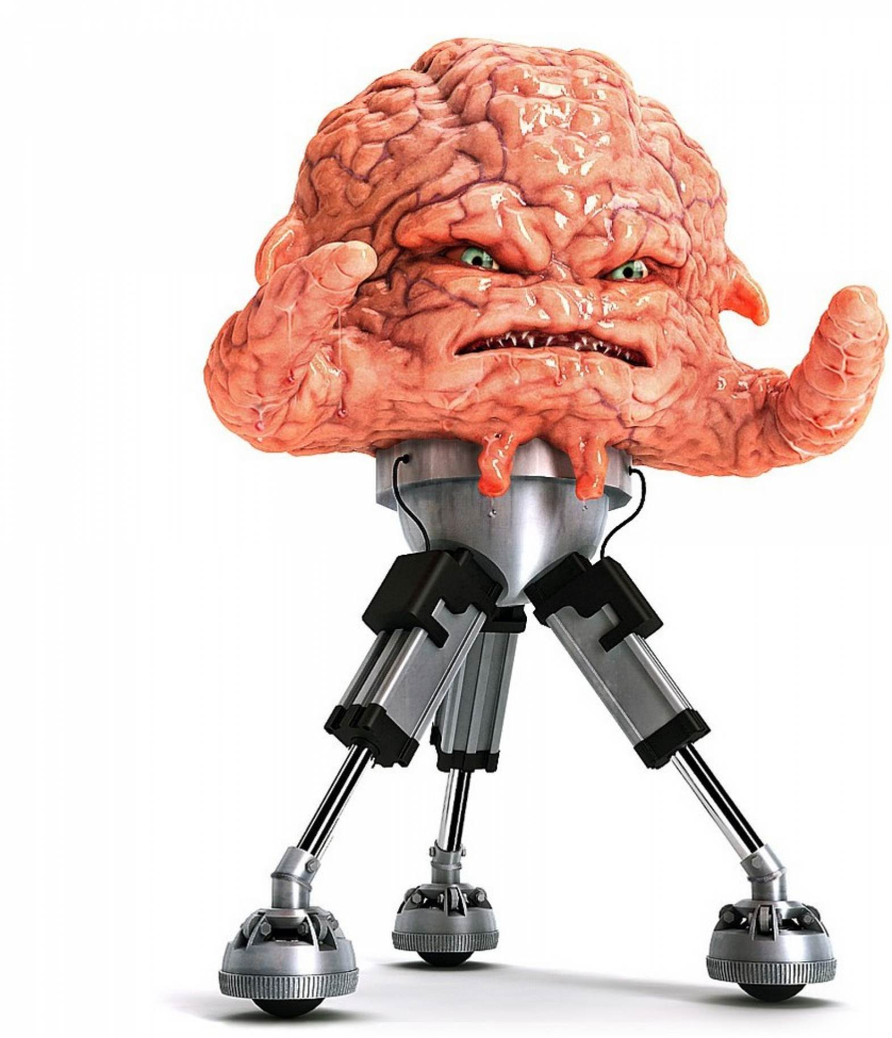
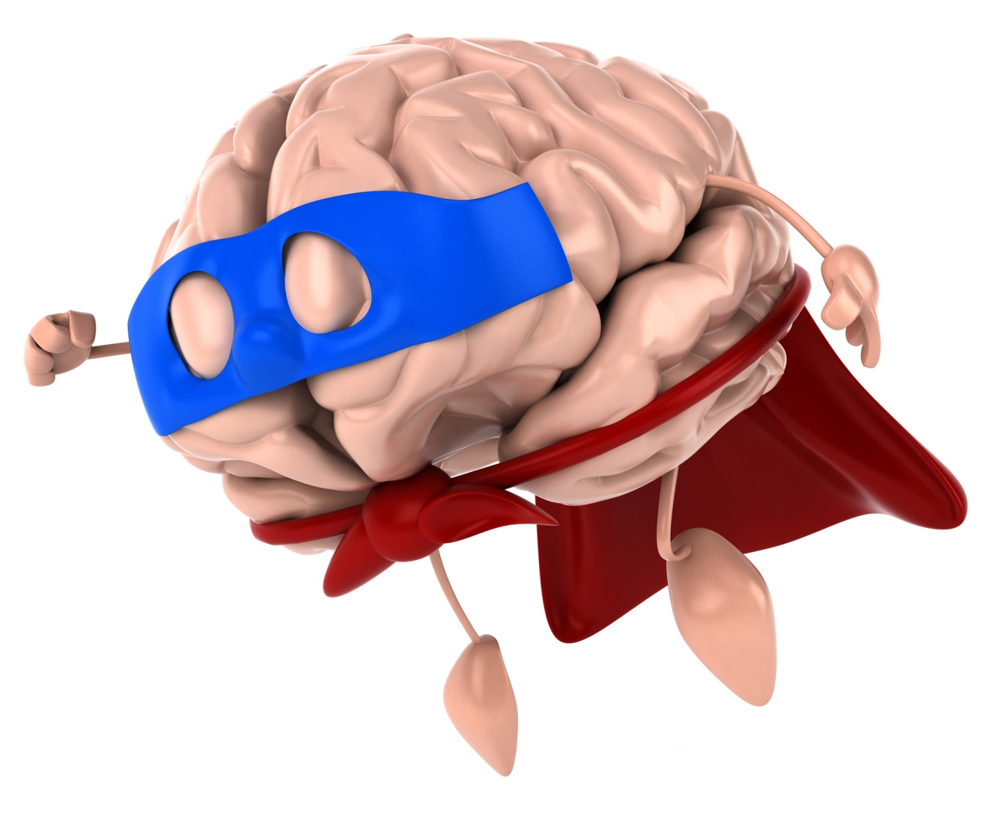
Notes:
The answer is both. Our brains play the role of both hero and villain because they only understand the concept of habit – they can’t differentiate between good habit and bad habit so whatever we persist in doing will get hardwired into our brains and embedded as habit.
I’m going to be focusing on the brain today because that’s the seat of our habits – everything begins with a thought
So let’s drill a little deeper into how habit is formed in the brain.

Slide 10
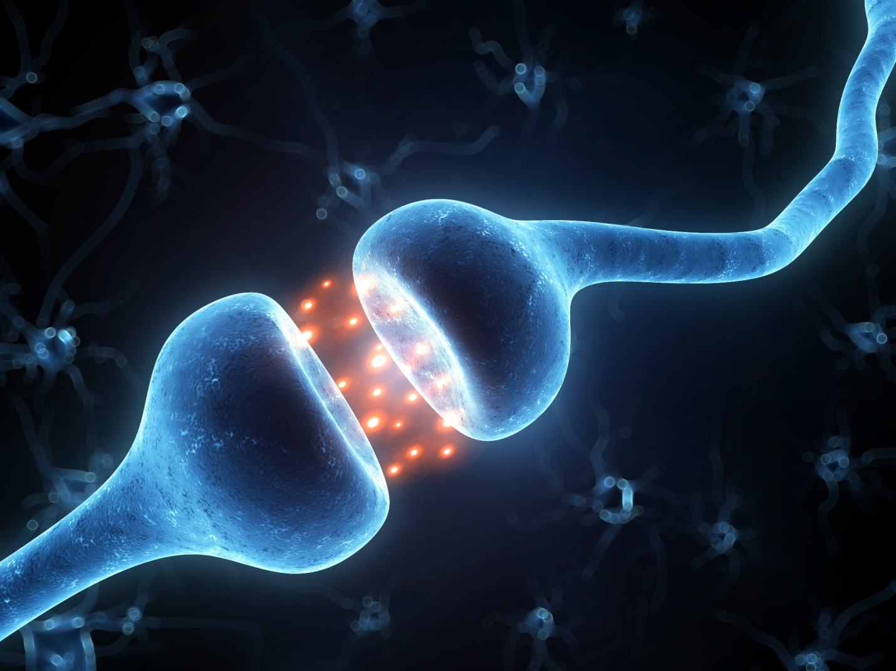
Notes:
The formation of habit in the brain is a fairly complex process so I’m going to share the most important aspects of the process. Once we understand how habits form then we are well on the way to being able to change them permanently.
In our brains we have about 100 billion of these little things called neurons and each neuron is capable of making 10,000 connections with other neurons across a gap called a synapse. Chemicals called neurotransmitters are released whenever we perform an action or learn and we have what we call the firing of a neuron. At any one time we can have around a quadrillion synaptic connections firing off – that’s more connections than there are grains of the sand on the earth or stars in the Milky Way!
The more this happens, the stronger the connection becomes until, after being repeated so many times, it becomes a habit.
So how many times are we looking at?
(Relate back to How to Grow Your Brain)

Slide 11
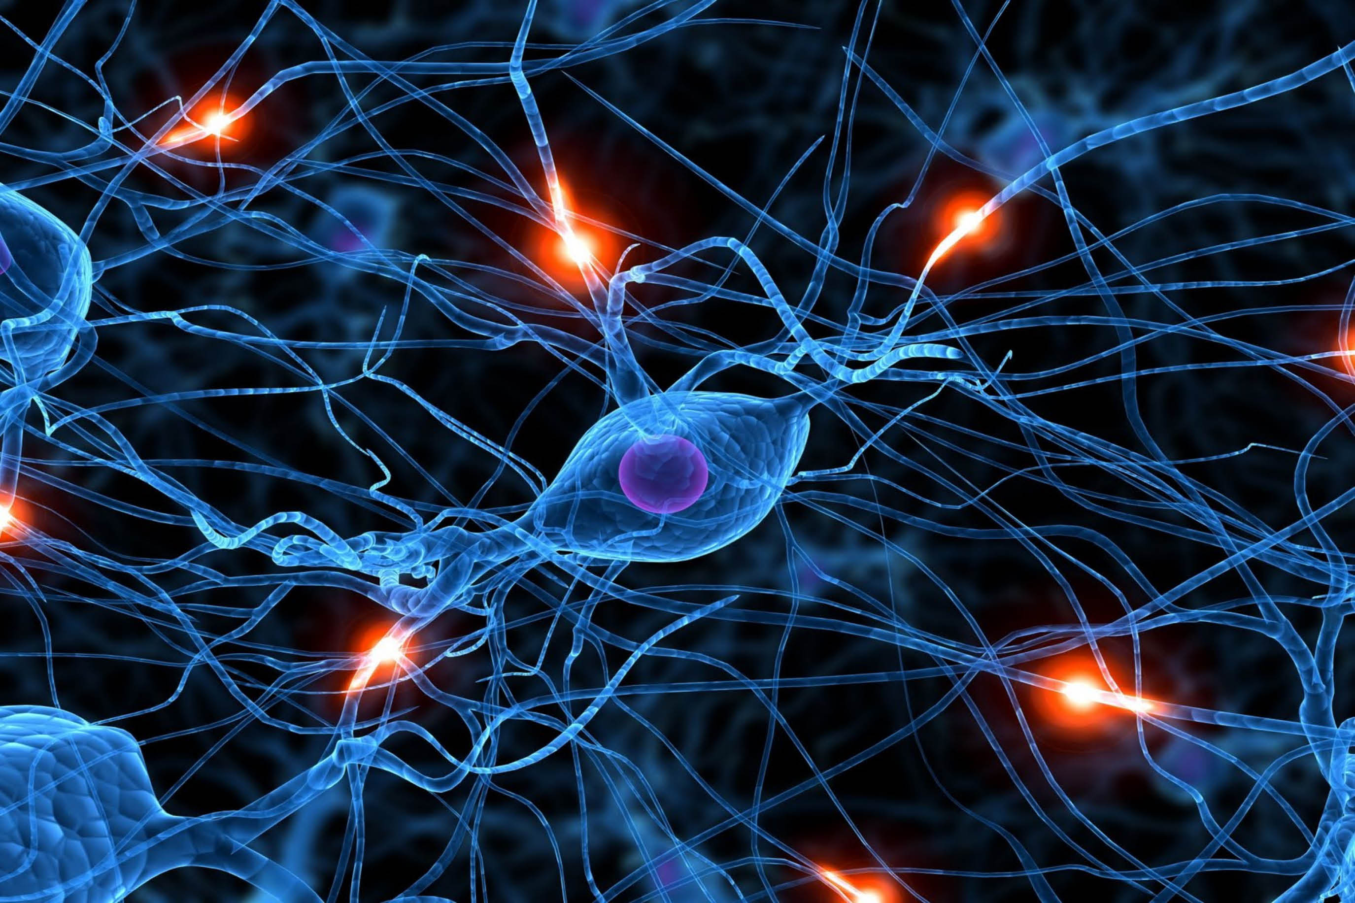
“What
fires
together,
wires
together”
Hebb’s Law
66
Notes:
According to researchers from University College London - there is no one standard time period for a habit to form — it can take anywhere from 18 to 254 days. More specifically, the period of time depends on the difficulty of the activity being learned e.g. it’s easier to train yourself to drink an extra glass of water each day than to do 30 minutes of intensive exercise, and the level of commitment on the part of the individual. Lally and colleagues discovered that, on average, participants learning to form a new habit succeeded within 66 days. By the 66-day mark, the repeated practice of those activities had hit their plateau of learning increases, and thus, the behaviours became as automatic as they ever would become.
Me in week 3 of an 8 week program – 56 days – write on board – backwards and forwards – so the message there is PLEASE don’t give up if you’re not noticing a change in 21 days – that’s an urban myth.
So why is it SO difficult to change our habits? Let’s look at how habits are created from the perspective of the brain.
Suggest a habit to me
Habits are hard to break because they are so strongly wired into our brains. Hebb’s Law states that ‘Neurons that fire together wire together’. Essentially, what this means is that when groups of nerve cells (or brain regions) are repeatedly activated at the same time, they form a circuit and are ‘locked in together’.
Once this circuit is established, the brain areas involved in the circuit automatically respond in the same way every time a similar situation is encountered. This in turn leads to the circuit becoming stronger and more and more re-enforced. Such a process is crucial to learning – riding a bike, for example. However, it can also be associated with bad habits like overeating or reaching for the bottle when we are stressed.
There’s good news though - by understanding how habits are formed, we can rebuild those patterns in whichever way we choose.

Slide 12
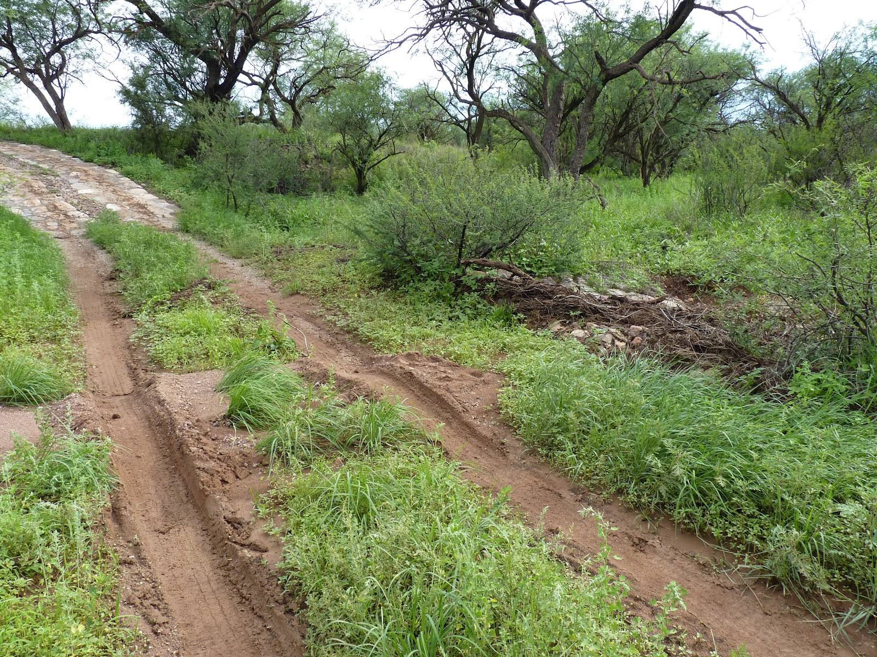
Notes:
For those of you who are visual, imagine our neural circuitry looking like this once a habit is embedded.
How easy do you think it would be to drive outside of those lines? You might fall back in but in time you could forge a new pathway.
But you could do it with effort couldn’t you?
So where in our brains does this habit reside

Slide 13
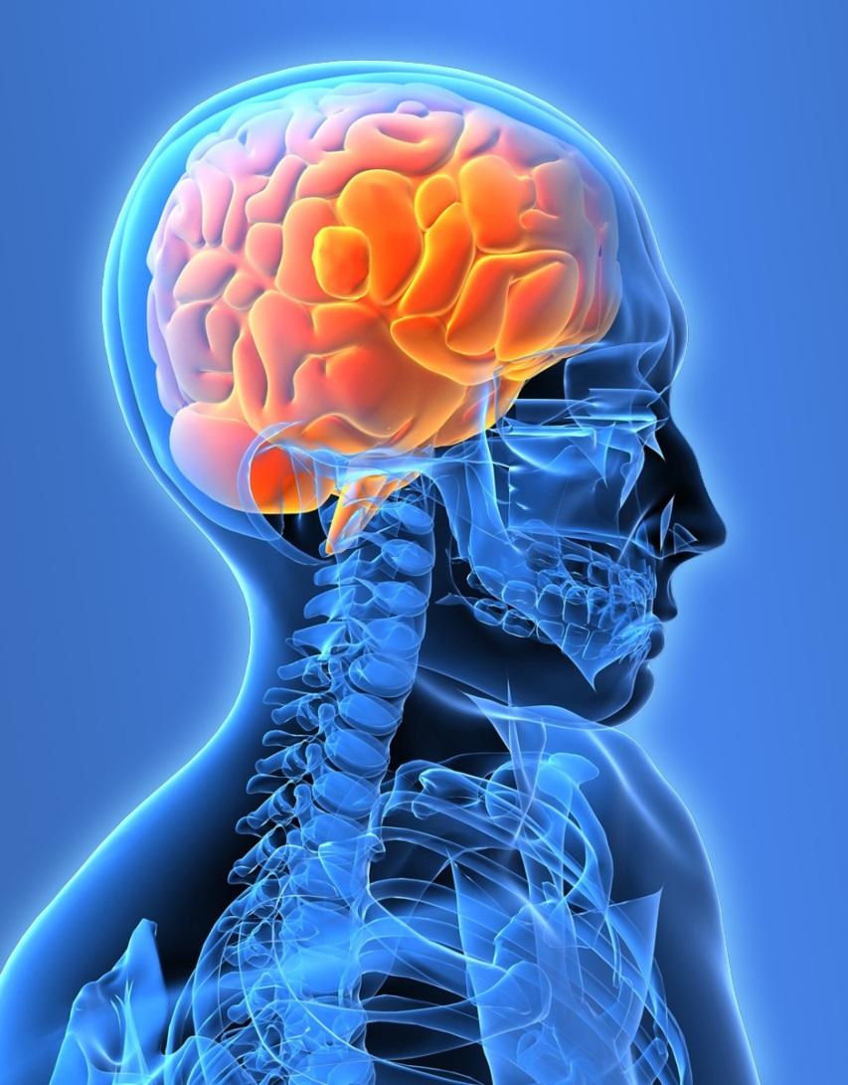
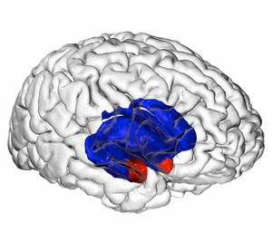
Basal Ganglia
Amygdala
Notes:
Samuel Johnson is quoted as saying “the chains of habit are too weak to be felt until they are too strong to be broken” - well in the 1780’s they hadn’t heard of the concept of neuroplasticity – the fact that we can rewire our brains, we can heave our neural 4WD out of the ruts and create new habit grooves
In the past decade, our understanding of the neurology and psychology of habits and the way patterns work within our lives, societies, and organisations has expanded in ways we couldn’t have imagined fifty years ago.
The basal ganglia play a large role in movement control, emotion, cognition, and reward-based learning. For example, when we move a part of our body in a new way and it feels good, for example salsa dancing, the reward part of our basal ganglia is activated, also when we feel a sense of accomplishment for having tried something new, the same thing happens. Our brain then experiences reinforcement (formation beginning) that this new activity is one that serves us well and so we get a reward whether conscious or unconscious from performing the action, which is why we want to keep performing it and habit is formed.
Let’s look at a simple example of HOW a habit is formed

Slide 14
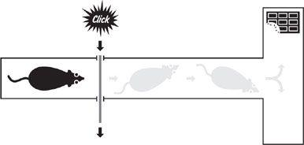
As each rat learned how to navigate the maze, its mental activity decreased
Within a week, the brain structures related to memory had quietened, voila – a habit is born
Notes:
In the early 1990s, the MIT researchers began wondering if the basal ganglia might be integral to habits. They noticed that animals with injured basal ganglia suddenly developed problems with tasks such as learning how to run through mazes or remembering how to open food containers. In surgery, each rat had what looked like a small joystick and dozens of tiny wires inserted into its skull. Afterward, the animal was placed into a T-shaped maze with chocolate at one end.
The maze was structured so that each rat was positioned behind a partition that opened when a loud click sounded. Initially, when a rat heard the click and saw the partition disappear, it would usually wander up and down the centre aisle, sniffing in corners and scratching at walls. It appeared to smell the chocolate, but couldn’t figure out how to find it. When it reached the top of the T, it often turned to the right, away from the chocolate, and then wandered left, sometimes pausing for no obvious reason. Eventually, most animals discovered the reward. But there was no discernible pattern in their meanderings. It seemed as if each rat was taking a leisurely, unthinking stroll. The probes in the rats’ heads, however, told a different story.
While each animal wandered through the maze, its brain—and in particular, its basal ganglia—worked furiously. Each time a rat sniffed the air or scratched a wall, its brain exploded with activity, as if analysing each new scent, sight, and sound. The rat was processing information the entire time it meandered.
The scientists repeated their experiment, again and again, watching how each rat’s brain activity changed as it moved through the same route hundreds of times. A series of shifts slowly emerged. The rats stopped sniffing corners and making wrong turns. Instead, they zipped through the maze faster and faster. And within their brains, something unexpected occurred: As each rat learned how to navigate the maze, its mental activity decreased. As the route became more and more automatic, each rat started thinking less and less. It was as if the first few times a rat explored the maze, its brain had to work at full power to make sense of all the new information. But after a few days of running the same route, the rat didn’t need to scratch the walls or smell the air anymore, and so the brain activity associated with scratching and smelling ceased. It didn’t need to choose which direction to turn, and so decision-making centres of the brain went quiet. All it had to do was recall the quickest path to the chocolate. Within a week, even the brain structures related to memory had quieted. The rat had internalized how to sprint through the maze to such a degree that it hardly needed to think at all.
Habits are necessary shortcuts for our brains: But that internalization—run straight, hang a left, eat the chocolate—relied upon the basal ganglia, the brain probes indicated. This tiny, ancient neurological structure seemed to take over as the rat ran faster and faster and its brain worked less and less. The basal ganglia was central to recalling patterns and acting on them. The basal ganglia, in other words, stored habits even while the rest of the brain went to sleep…Millions of people perform this intricate ballet every morning, unthinkingly, because as soon as we pull out the car keys, our basal ganglia kicks in, identifying the habit we’ve stored in our brains related to backing an automobile into the street.
The steps identified by the MIT researchers formed a 3 step habit loop.

Slide 15

The Habit Loop
Notes:
The researchers at MIT were able to break the formation process of a habit down into 3 steps which, when we really analyse our thoughts, actions and behaviours we can recognise in ourselves.

Slide 16
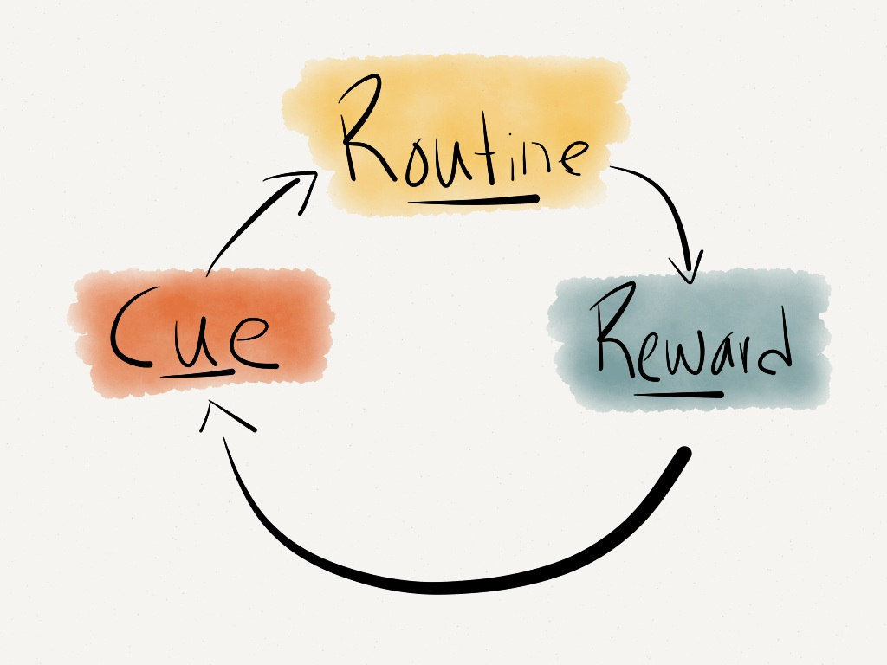
The Habit Loop
2.
1.
3.
CRAVING
From the Power of Habit by Charles Duhigg
Notes:
First there is the cue or trigger for the behaviour followed by the routine or behaviour itself then a reward which is how our brain learns to remember this pattern for the future.
Craving – but for what?
Cue – the trigger that sets off the routine
Routine – the ‘habit’ you do
Reward – how the craving is satisfied (can be different rewards)
So this morning you may have looked at the clock then jumped into frenzy mode to get yourself to where you need to get to and when you arrive on time there’s a sense of accomplishment. You might be craving time for yourself, work life balance, organisation – often we're unaware of the craving.

Slide 17
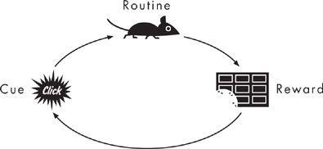
From the Power of Habit by Charles Duhigg
Notes:
So for our little rat friend the cue or trigger was the sound of the click and the opening of the partition, the routine was to wander the maze in search of the reward – chocolate, the craving, probably food – no idea how long it had been since he was fed!
So let’s move on from rats to humans.
Who here likes to go for a regular run?

Slide 18
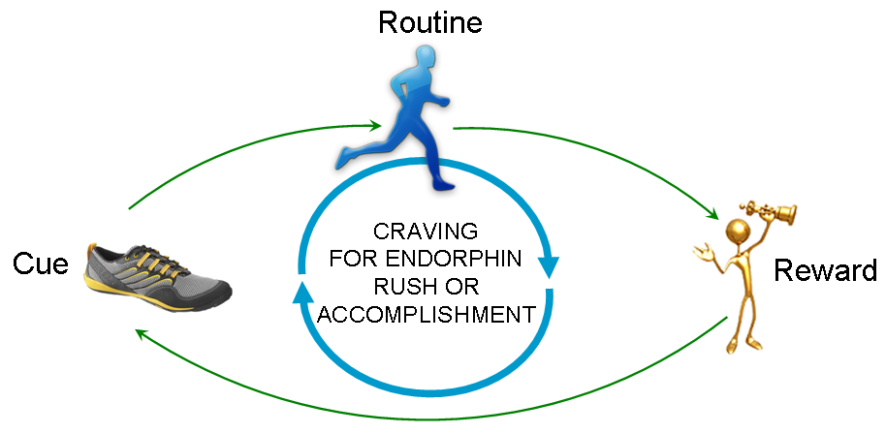
The Habit Loop
From the Power of Habit by Charles Duhigg
Notes:
So your cue might be grabbing your running shoes or a particular time of day, you go for the run and how do you feel afterwards?
I don’t like running but I LOVE the feeling afterwards and now I have a running app I’m getting hooked on personal bests.
The reward could be how energised you feel, doing a personal best, winning a competition, raising money
The craving could be a number of things – what the run does for you, time out, completion of fitness goals.
Time to progress to study-based habits

Slide 19
Study/School Based Habits
?
Notes:
What are some of the ineffective habits or repetitive behaviours we get into at work that don’t help us with our effectiveness?
Elicit and scribe

Slide 20

Notes:
Is this you??
How many of you suffer from bad cases of distractions when you are in class or trying to study?

Slide 21
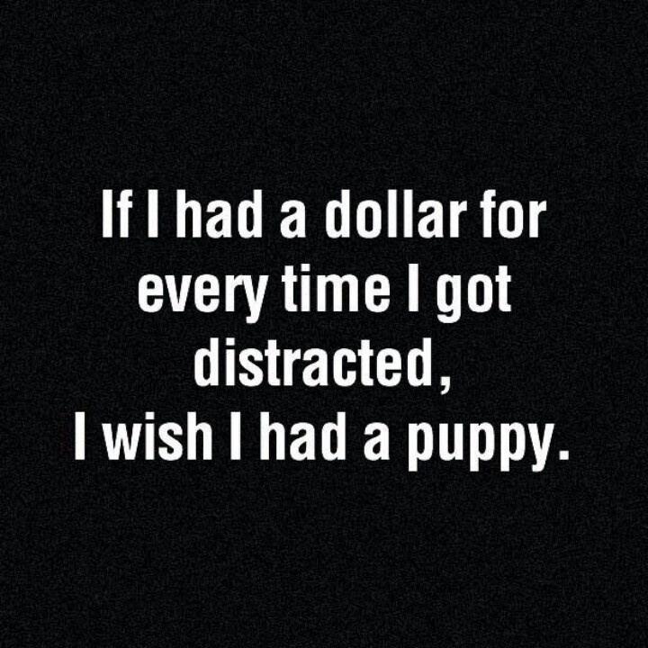

Slide 22


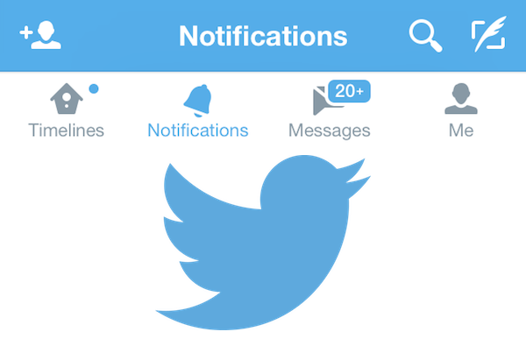

Notes:
So you’re busily working on a really important piece of work and that little box pops up in the corner – what do you do?
How many of you can easily ignore it regardless of who it’s from and what the subject title is?
How many of you have it turned off?
How many of you secretly enjoy this little diversion?
It’s perfectly normal – there’s a part of our brain that is continually scanning for novelty and distraction
So lets say this has formed into a habit and let’s look at it from the habit loop perspective.
Can you remember the 3 elements of the loops
Cue/trigger
Routine
Reward
Foundation of craving

Slide 23
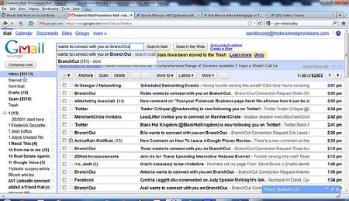
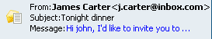
Curiosity?
Distraction?
Relief from complexity
Notes:
So the little box or sound appearing is the cue and choosing to open rather than ignore is the routine or behaviour.
The reward may be that you’ve cleared it from your screen and therefore it’s a sense of accomplishment or that you’ve satisfied your curiosity and given your brain a little hit and got a little dose of dopamine which is our happy hormone.
What might you be craving?

Slide 24

Notes:
A new study from MIT in 2012 showed that the executive planning centre of our brain doesn’t relinquish all control of habits as previously thought. It shows that though habits may be deeply ingrained, the brain’s planning centres can shut them off so there is light at the end of the tunnel.

Slide 25
Strategies to change existing Habits
Notes:
So unless you deliberately fight a habit - unless you find new routines - the pattern will unfold automatically.
Let’s revisit our 3 step habit loop and see where we can interrupt or change the pattern to help us change our habit.

Slide 26

“To change an old habit, we must address an old craving, keep the old cue, deliver the old reward but feed the craving by inserting a new routine”
https://www.youtube.com/watch?v=W1eYrhGeffc
Notes:
So often when we try to change an existing habit we just say, from tomorrow I’m going to stop. There’s no rational analysis, no understanding of how our brain has been carving these deep neural pathways and so we set ourselves up for failure.
Now we have the knowledge we can make the changes.
Let’s delve a little deeper into the habit loop
(Watch video-Optional)

Slide 27
Triggered by the old cue
Delivers same reward
Set an implementation intention
Time
Location
Company
Previous action
Emotion
Craving?
Substitute
Work?
Yes – great
No – try another reward
Notes:
Step 1 with the cue is to ask yourself
What time is it
Where am I
Who am I with
What was I just doing
How am I feeling
Step 2
What is it I’m really craving? Was it the cookie?
Step 3
What is my reward?

Slide 28
Choice?
Curiosity?
NOVELTY, CHANGE,
DISTRACTION
DOPAMINE HIT?
Notes:
So we’ve identified that the routine is opening up our mail to satisfy our curiosity. In order to change the routine it helps to question our craving. What choices do we have?
We could turn the email notification system off and remove the distraction which is what I do because I’m just too nosey. My business associate leaves it on and uses it as an opportunity to practise her willpower and says “oh how interesting, another email and a little hit of dopamine, I’m in charge and will deal with it later”
We could schedule a time for when we’ll open up the emails – we’ll cover this a little later and it’s all part of increasing our productivity, so we still get to satisfy our curiosity AND deploy our skills of delayed gratification!

Slide 29
> Address an old craving
> Keep the old cue
> Deliver the old reward
> Insert a new routine
Notes:
So how do we go about creating new habits?

Slide 30
Creating Successful HABITS
Have a clear plan
Align actions with goals & values
Believe that change is possible
Identify the cue, routine, reward
Try different rewards, then change the routine
Show others how it’s done!

Slide 31

“We are what we repeatedly do. Excellence, then, is not an act,
but a habit” Aristotle, 384 – 322 BCE

Slide 32
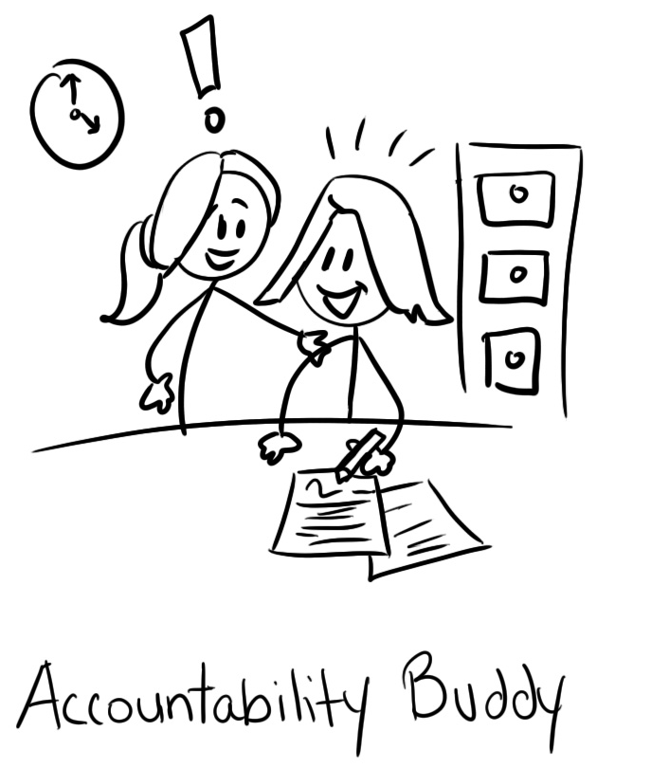
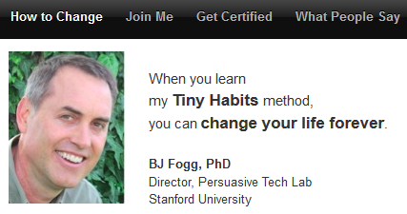
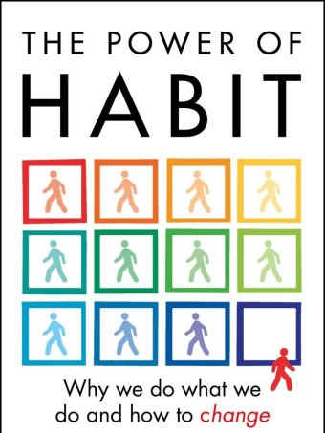


Resources
www.tinyhabits.com

