Slide 1
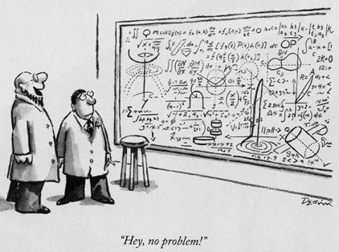
Taking Better Notes and Using Notes Better

Slide 2
Rule One:
Take Notes!
Taking notes engages you in listening and keeps you focused on the lecture or discussion. There are multiple methods of note taking.

Slide 3
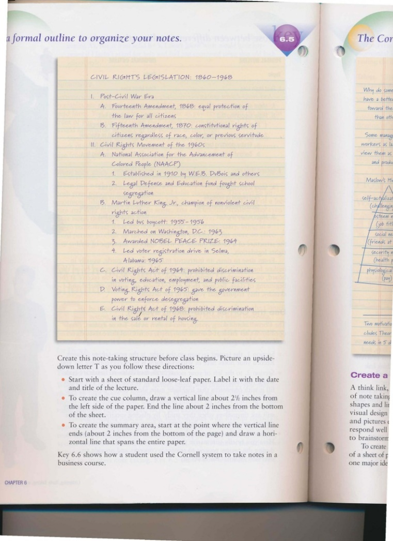
Outline
Use Outline when you the subject is chronological or has clear topics and subtopics.
You may make a formal outline with letters and numbers or an informal outline with arrows or dashes.
Outlines can be very detailed or very general.
It is easy to leave extra space in an outline to look up the material later.

Slide 4
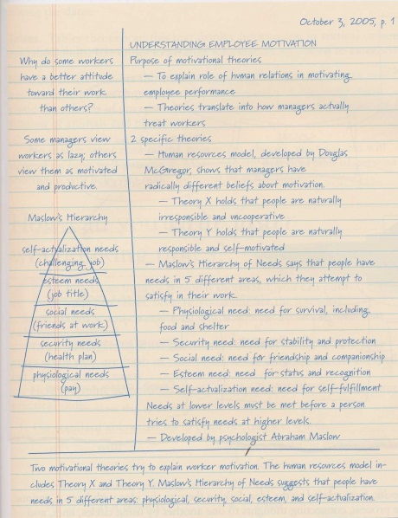
Cornell or T
This is useful when you have read the material ahead of time or have an idea of what will be discussed.
Divide your page in three parts by drawing a vertical line just left of center and a horizontal line about a fourth of the way from the bottom.
The larger part is the notes area. Write important items in this area as you listen. You might even want to use the OUTLINE METHOD in this box.
The box on the left is for you to fill in as you review. Draw diagrams or work sample math problems.
The bottom box is to summarize the concepts on the page. You could write the things you are sure will be on the test.

Slide 5
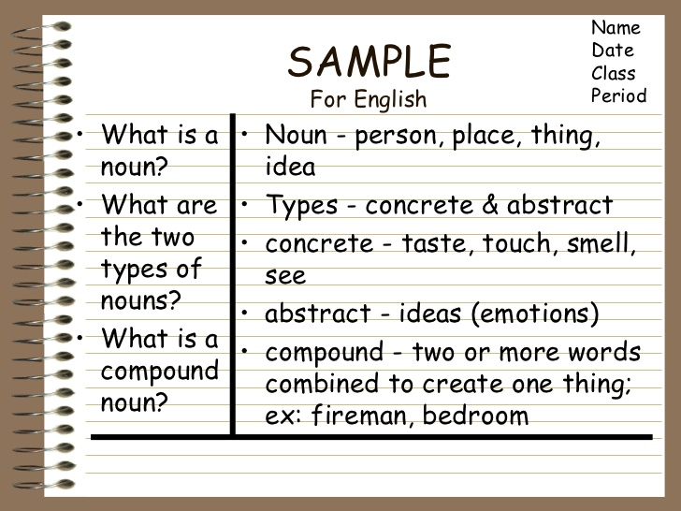
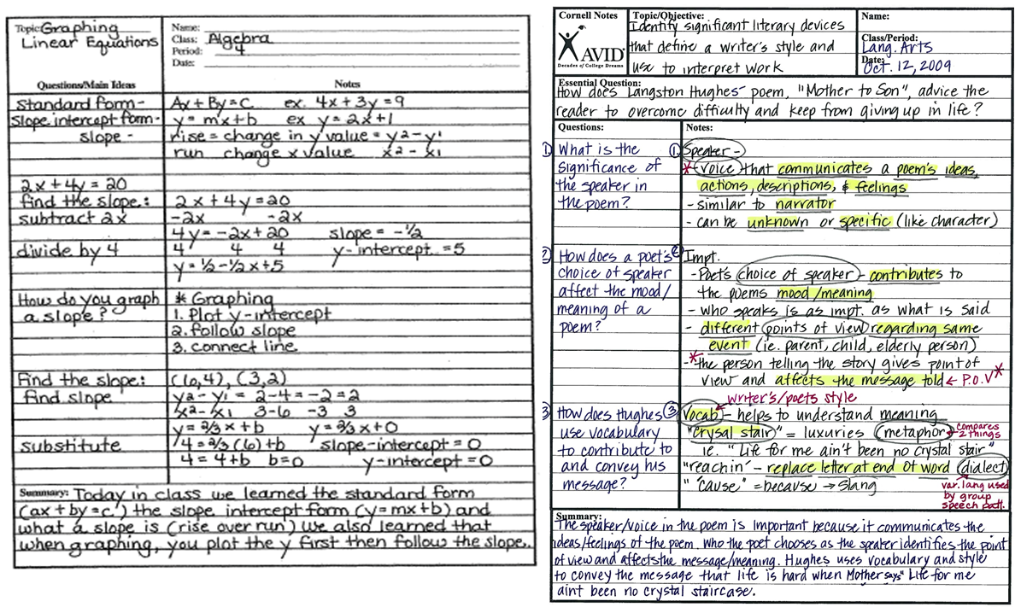
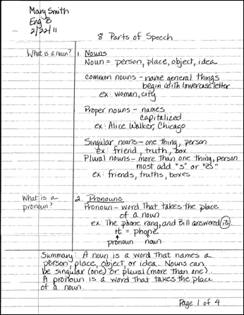

Slide 6
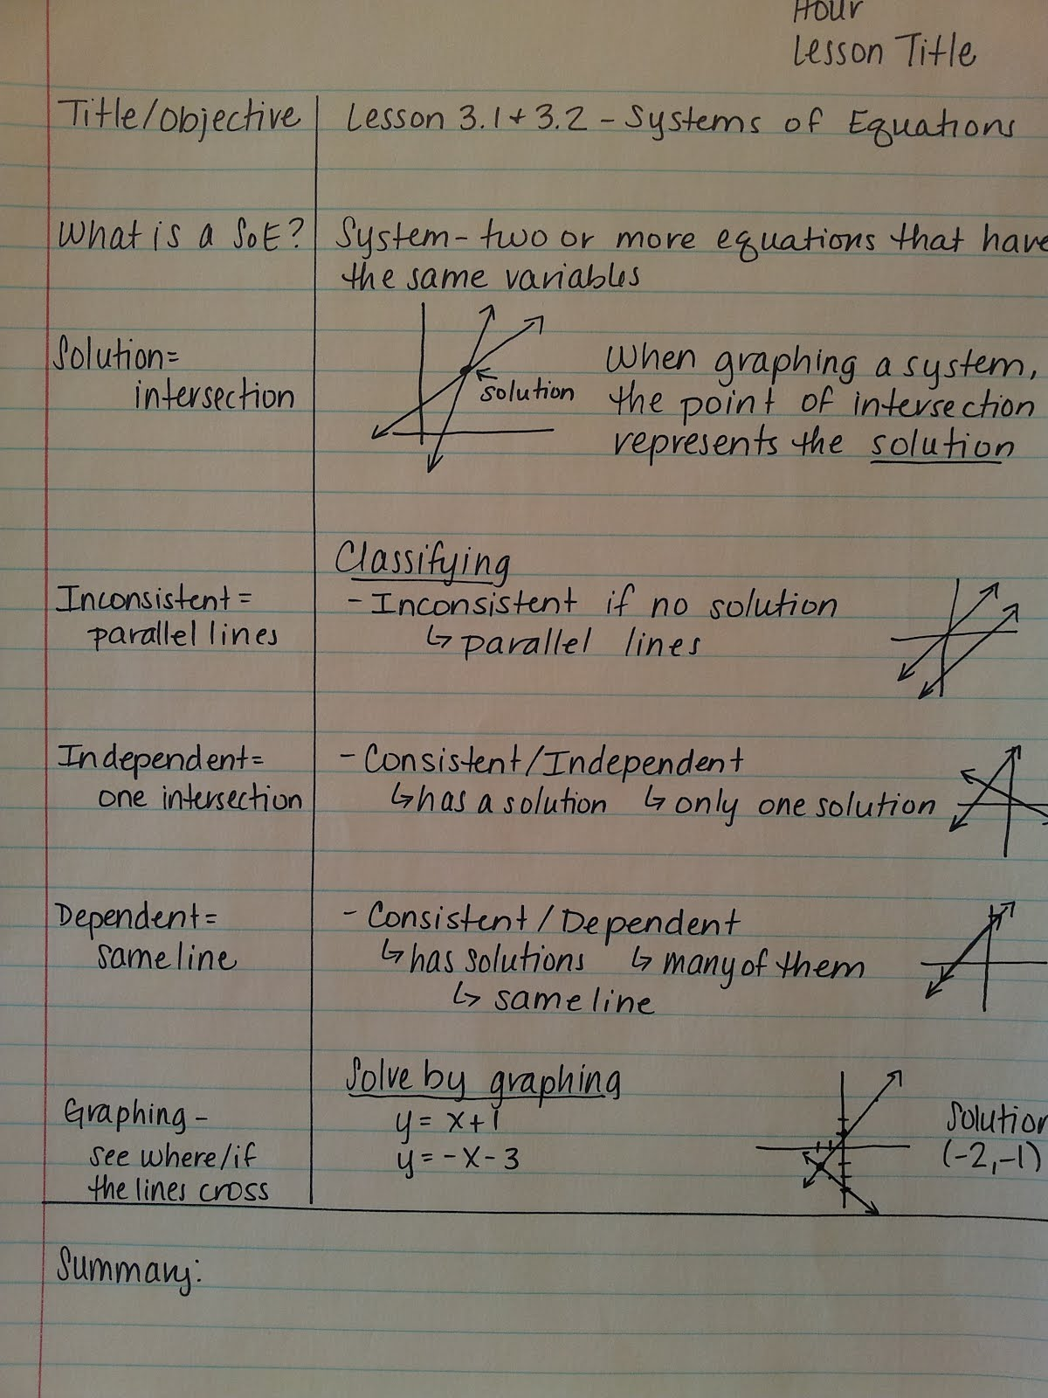

Slide 7
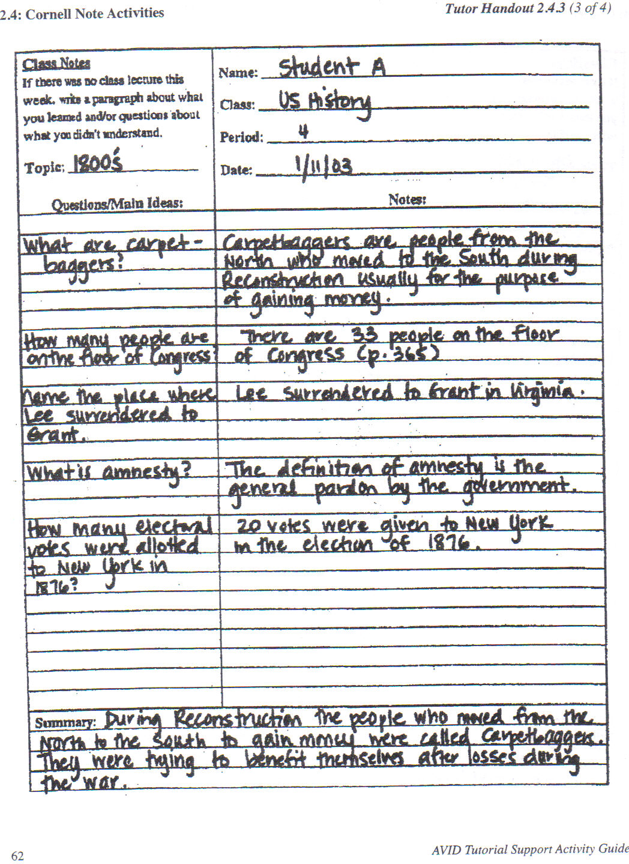

Slide 8
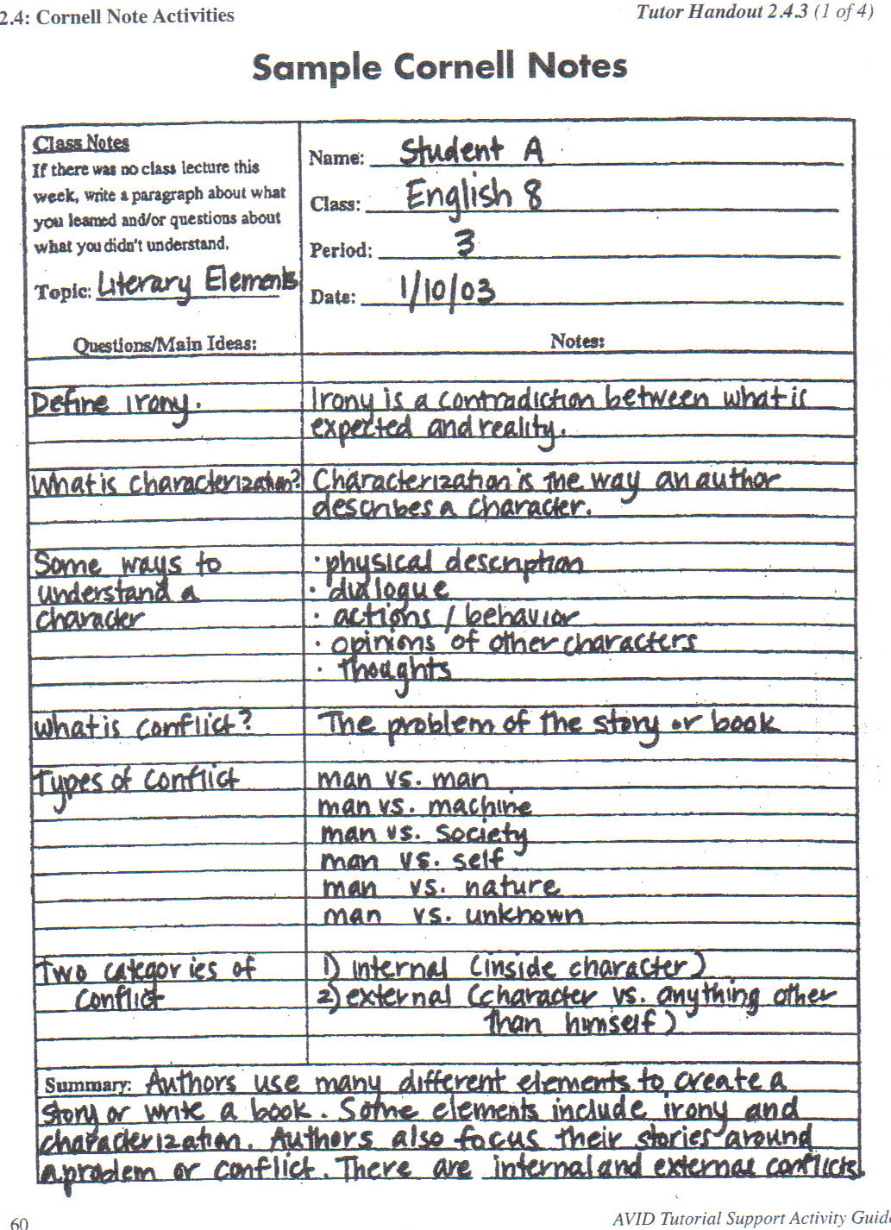

Slide 10
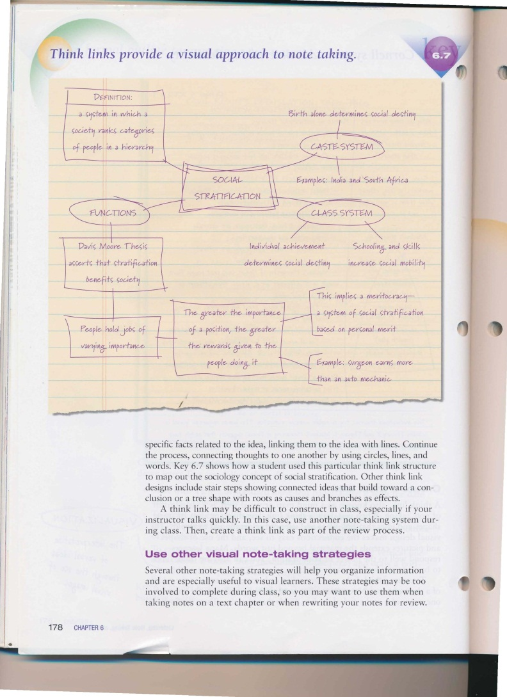
Think Link/ Concept Map
A think link is useful when you need to compare or contrast concepts.
Visual learners find these useful.
Start by writing your topic in the center of the paper with a box around it.
Draw a line out from the box and write one major idea at the end of the line. Box or circle that.
Then jot down facts related to that idea.

Slide 11
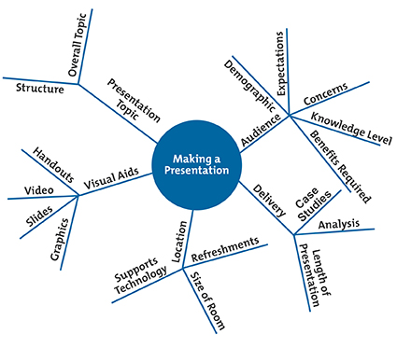
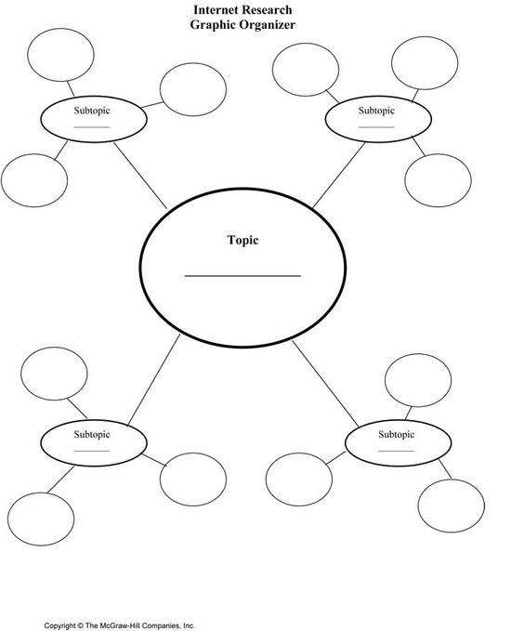
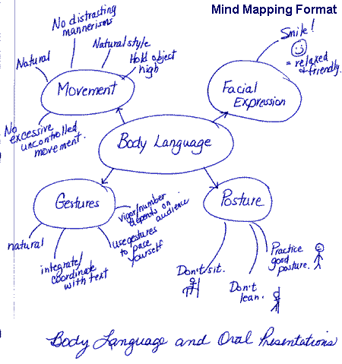
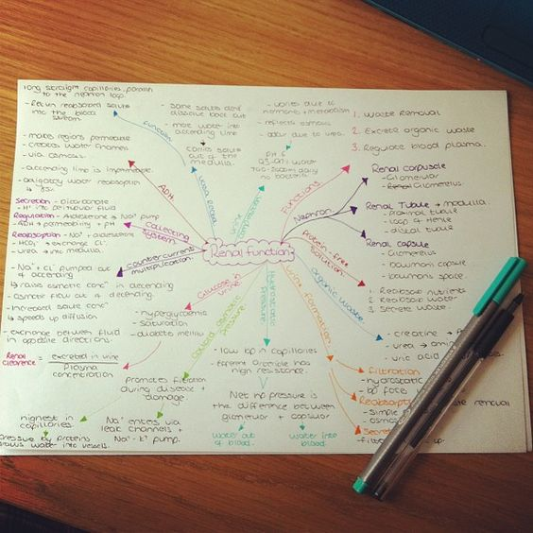

Slide 12
Rule Two:
Don’t write down every word.
Use symbols and abbreviations then fill in the spaces later.

Slide 13
Some Common
Symbols and Abbreviations
w/ with
w/o without
= is, means
= isn’t
# number
ng no good
+ or & and
≈ approximately
You may have some of your own
/

Slide 14
Rule Three
Rewrite your notes.
Transcribing your notes to a new notebook or the computer within 24 hours reinforces learning.

Slide 15
Ways to Transcribe Notes
Keep a “First Notes” spiral and a “Final Notes” spiral and copy your notes into the “Final Notes” spiral.
Use different colored pencils or highlighters or post-it notes to organize and identify important information.
Transfer the notes from one style to another.
Type your notes into a Word Document.
Type your notes into a blog.

